Slide 1
FUNCTIONS
C PROGRAMMING
Mr R. TLEMSANI

Slide 2
The procedures
A procedure is a set of named instructions. To define a procedure, we use the syntax:
void procedureName ( )
{
/
instructions
/
}
A procedure is a new instruction; all you need to do to execute it is use its name.

Slide 3
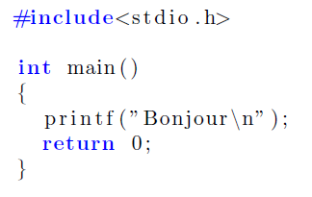
The procedures
For example, to execute (also called call or invoke) a procedure called pr , simply write pr(); The following two programs do the same thing. The first is written without procedure:

Slide 4
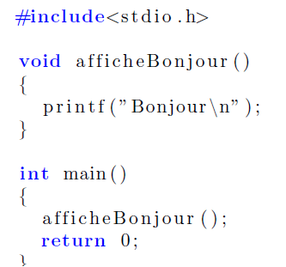
The procedures
And in the second, the printf is placed in the procedure displaysHello and this procedure is called from the main.

Slide 5
The procedures
You can define as many procedures as you want, and you can call procedures from procedures.
main is also a procedure. main is executed automatically when the program is launched.

Slide 6
Local variables
A procedure is a block of instructions and is subject to the same rules as main. It is therefore possible to declare variables:
void procedureName ( )
{
/
declaration of variables
/
/
instructions
/
}
Attention, these variables are only accessible in the body of the procedure , this means that they are born at the time of their declaration and that they are destroyed once the last instruction of the procedure has been executed. This is why they are called local variables . A local variable is only visible between its declaration and the curly brace closing the procedure.

Slide 7
Local variables
Likewise, the variable a is declared in myProcedure , it is not visible in the main .
For example, this code is illegal:
#include<stdio . h>
void myProcedure ( )
{
char a = b ;
}
int hand ( )
{
char b = 'k';
myProcedure ();
printf ( "%c , %c \n" , a , b );
return 0;
}
In fact, the variable b is declared in the main procedure , and is therefore only visible in this same procedure. Its use in myProcedure is therefore not possible.

Slide 8
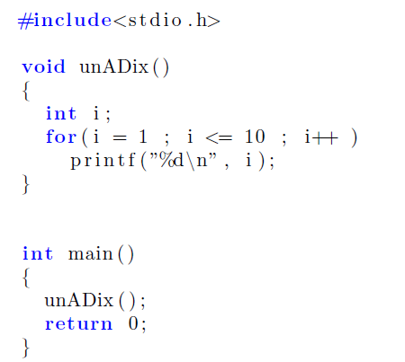
Local variables
Here is an example of using local variables:

Slide 9
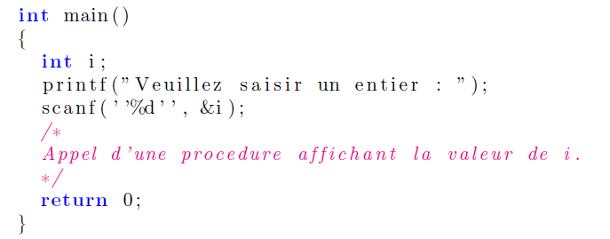
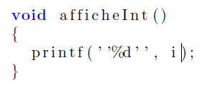
Passing parameters
It is possible that the value of a local variable of a procedure is not known until the procedure is called. Consider the following program:
How to define and invoke a displayInt procedure to display this integer entered by the user? You will agree that the following procedure will not pass compilation

Slide 10
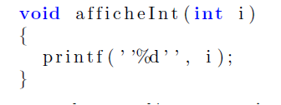
Passing parameters
Indeed, the variable i is declared in the main , so it is not visible in displayInt. To remedy this, we define displayInt like this:
i is then called a parameter , it is a variable whose value will be specified when the procedure is called. We can also consider that i is an unknown value, and that it is initialized when the procedure is invoked.

Slide 11
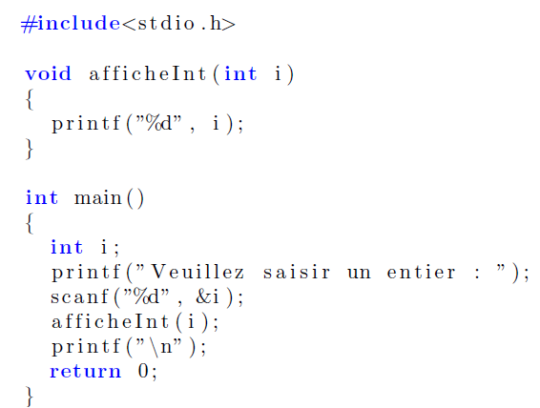
Passing parameters
To initialize the value of a parameter, this value is placed between parentheses when calling the procedure, for example: displaysInt(4) launches the execution of the procedure displaysInt by initializing the value of ia 4. We say also that we pass the value 4 as a parameter. The correct version of our program is:

Slide 12
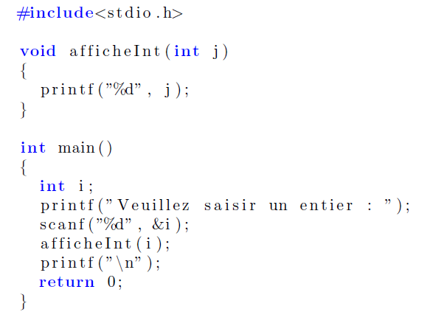
Passing parameters
Attention,
note that the i of printInt and the i of main are two different variables , the only thing that binds them is that the instruction printInt(i) initializes the i of printInt to the value of
i of the hand.
It would be quite possible to write:

Slide 13
Passing parameters
It is possible to pass several values as parameters.
For example, the following procedure displays the sum of the two values passed as parameters:
The invocation of such a procedure is done by initializing the parameters in the same order and separating the values by commas, for example displaysSum(3, 4) invokes displaysSum by initializing a to 3 and b to 4. You must initialize all parameters and you must place the values in order.

Slide 14
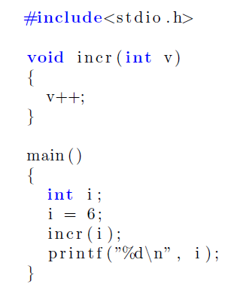
Passing parameters
EXAMPLE
What does the following program display?

Slide 15
The functions The principle
We have seen that a subroutine caller can communicate values to the called subroutine .
But is it possible for a called subroutine to communicate a value to the subroutine calling ?
The answer is yes.
A function is a subroutine that communicates a value to the calling subroutine. This value is called return value , or returned value .

Slide 16
Summon functions
The syntax for calling a function is:
v = functionName ( parameters );
The above instruction places in the variable v the value returned by the function functionname when passing it the parameters parameters .

Slide 17
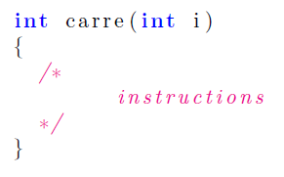
Functions Definition
We define a function with the following syntax:
typeReturnValue functionName ( ParameterList )
{
}
The square function will therefore be defined as follows:
A function is a lot like a procedure. You notice that void is replaced by int , void means no return type , a procedure is therefore a function that returns nothing .

Slide 18
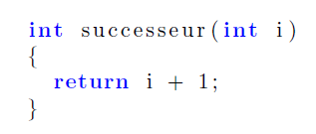
Functions Definition
The instruction used to return a value is return . This statement interrupts the execution of the function and returns the value placed immediately after.
We define a function which returns the successor of its parameter:
This function, if we pass the value 5 as a parameter, returns 6. For example, the instruction
v = successor(5);
assigns the value 6.

Slide 19
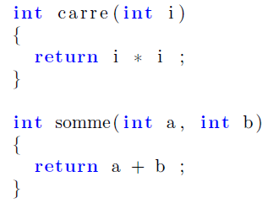
Functions Definition
Now let's construct the two functions:
You will note that a function cannot return an array , a function can only return scalar values .

Slide 20
Parameter passing by reference
In C, when you invoke a function, all the values of the effective parameters are copied into the formal parameters.
In this case we say that the parameter passing is done by value. You can therefore, a priori , communicate only one value to the calling program. Effectively :
only the return value will allow you to communicate a value to the calling program.
a function can only return scalar values.

Slide 21
Parameter passing by reference
When you pass an array as a parameter, the value that is copied into the formal parameter is the address of this array (the address is a scalar value).
Consequently, any modification made to the elements of an array whose address is passed as a parameter by value will be reflected on the effective parameter (ie the original array).
When medications made on a formal setting in
a subroutine are passed on to the effective parameter, we then have a parameter pass by reference . We will therefore remember the following three golden rules:
Scalar variables are passed as parameters by value
Non-scalar variables are passed as parameters by reference
A function can only return scalar values

