Slide 1
THE TABLES
C PROGRAMMING
Mr R. TLEMSANI

Slide 2
INTRODUCTION
Consider a program whose execution gives:
Enter ten values:
1:4
2:7
3:34
4:1
5:88
6:22
7:74
8:19
9:3
10:51
Enter a value
22
22 is the 6th ^{value} entered
How to program this without using 10 variables to store the first ten values entered?

Slide 3
DEFNITIONS
An array is a grouping of variables of the same type , it is identified by a name . Each of the variables in the array is numbered, this number is called an index .
Each variable of the table is therefore characterized by the name of the table and its index.

Slide 4
DEFNITIONS
If for example, T is an array of 10 variables , then each of them will be numbered and it will be possible to find it using the name of the array and the index of the variable simultaneously.
The different variables of T will have numbers from 0 to 9, and we will call each of these variables an element of T .
0 | 1 | 2 | 3 | 4 | 5 | 6 | 7 | 8 | 9
e1 | e2 | e3 | e4 | e5 | e6 | e7 | e8 | e9 | e10
clues
T
elements

Slide 5
Noticed
A variable that is not an array is called a scalar variable .
an array as opposed to a scalar variable is a non-scalar variable .

Slide 6
STATEMENT
As the variables of an array must be of the same type, this type should be specified when declaring the array. Similarly, when declaring the array, specify the number of variables it contains.
The syntax is:
<type> <tablename> [ <size> ] ; _
For example,
int T[4];
declares an array T containing 4 int type variables.

Slide 7
INITIALIZATION
It is possible to initialize the elements of an array at the declaration, we do this as for scalar variables:
<type> <name>[<size>] = <initialization value>;
The only thing that changes is the way of writing the initialization value, we write in braces all the elements of the array, we arrange them in order of increasing index, separating them with commas.

Slide 8
INITIALIZATION
The general syntax of the initialization value is therefore:
<type> <name> [ <size> ] = { <value 0 >, <value 1 >, . . . , <value n -1> };
For example, we create an array containing the first 5 odd numbers like this:
int T[5] = {1, 3, 5, 7, 9};

Slide 9
ACCESS TO ELEMENTS
The elements of an n-element array are indices from 0 to n-1. We denote by T[i] the element of index i of the array T.
The five elements of the table in the example above are therefore noted
T[0], T[1], T[2], T[3] and T[4].

Slide 10
Example
we will declare an array E like this:
int E[10];
The above statement is for an array of 10 ints called E
It is then necessary to enter the 10 values.

Slide 11
Example
printf ( "Enter ten values: \n" );
printf ( "1" );
sc anf (%d" , &E [ 0 ] );
printf ( "2" );
sc anf (%d" , &E [ 1 ] );
printf ( "3" );
sc anf (%d" , &E [ 2 ] );
printf ( "4" );
sc anf (%d" , &E [ 3 ] );
printf ( "5" );
sc anf (%d" , &E [ 4 ] );
printf ( "6" );
sc anf (%d" , &E [ 5 ] );
printf ( "7" );
sc anf (%d" , &E [ 6 ] );
printf ( "8" );
sc anf (%d" , &E [ 7 ] );
printf ( "9" );
sc anf (%d" , &E [ 8 ] );
printf("10");
sc anf (%d" , &E [ 9 ] );
printf ( "Enter ten values: \n" );
for (i = 0; i < 10; i++)
{
printf ( "%d" , i +1);
sc anf ( "%d" , &E[ i ] ) ;
}
This type of loop is called an array traversal . As a general rule, loops are used to handle
arrays , these allow you to perform a process on each element of an array.

Slide 12
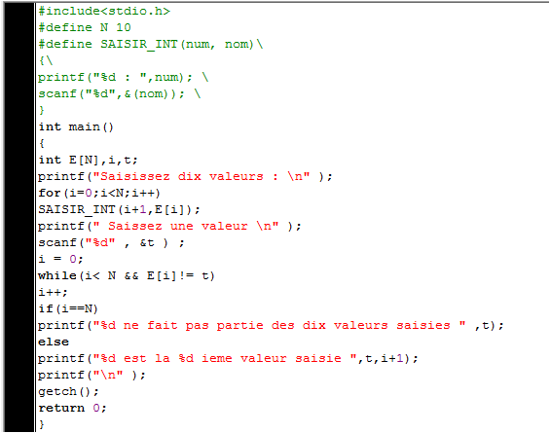
Example

Slide 13
Static arrays with 2 or more dimensions: MATRICES
definition
This is an array of arrays
statement
kind table_name [dim1][dim2]…[dimn]
examples:
char buffer[20][80];
int mat[6][10];
char pounds[100][60][80];

Slide 14
DIES
access to elements
table_name[ind1][ind2]…[indn]
examples :
book[30][15][20] = 'c';
mat[5][6] =13;
cost << mat[5][6]<<'\n';

Slide 15
Dynamic initialization
One-dimensional array
int * t;
t = (int*)malloc(20*sizeof(int));
function for automatic calculation of the size of an integer in bytes
table name
dynamic memory allocation function
number of elements in array

Slide 16
Dynamic initialization continued
Two-dimensional array n*m
dynamic declaration of array of n pointers and n one-dimensional arrays of m elements
a few lines of code are required

Slide 17
Dynamic initialization continued
Two-dimensional array n*m
int **TAB,l;
TAB = (int**)malloc(n*sizeof(int*));
for (l=0;l<n;l++)
{
TAB[l] = (int*)malloc(m*sizeof(int));
}
deallocation:
for (l=0;l<n;l++)
free(TAB[l]);
free(TAB);

