Slide 1
Buckles
C programming
REPETITIVE INSTRUCTIONS
Mr R. TLEMSANI

Slide 2
For what?
We want to create a program that displays all the numbers from 1 to 10, so the execution would be as follows:
1 2 3 4 5 6 7 8 9 10
A particularly nasty way to do this would be to write 10 successive printfs , with the cumbersome copy/paste that this would imply.
We are going to look at a way to code this type of program with a little more elegance.

Slide 3
Definitions and terminology
A loop allows you to execute the same sequence of instructions several times in a row. This set of instructions is called the body of the loop.
Each execution of the body of a loop is called an iteration , or more informally a pass through the loop.
When we are about to execute the first iteration, we say that we enter the loop, when the last iteration is finished, we say that we exit the loop.

Slide 4
Definitions and terminology
There are three types of loop:
while
do... while
for
Each of these loops has its advantages and disadvantages. We will review them later.

Slide 5
while
In C, the while loop is coded as follows:
while(<condition>)
{
<instructions>
}
Statements in the loop body are delimited by curly braces. The condition is evaluated before each pass through the loop, each time it is verified, the instructions of the loop are executed.
Once the condition is no longer true, execution continues after the closing brace.

Slide 6
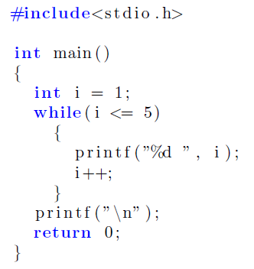
while
For example, let's display all the numbers from 1 to 5 in ascending order,
The variable i is called a counter , we manage the loop by successive increments of i and we exit the loop once i reaches a certain value.
Initializing the counter is very important!
If you do not initialize i explicitly, then this variable will contain any value and your program will not behave as expected at all.
Note also that there is no
semicolon after the while!

Slide 7
do... while
Here is the syntax for this loop:
do
{
<instructions>
}
while(<condition>);
The operation is similar to that of the loop except for a few details:
the condition is evaluated after each pass through the loop.
We execute the body of the loop as long as the condition is verified.
In C, the repeat...until loop is actually a repeat...while loop , that is, a while loop in which the condition is evaluated at the end.
A do ... while loop is therefore executed at least once.

Slide 8
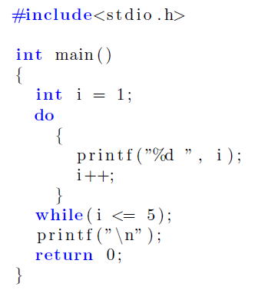
do... while
Let's return to the previous example with a do ... while loop:
In the same way as for the while loop, the counter is initialized before the first pass through the loop.

Slide 9
for
This loop is somewhat tricky . Let's start by giving its syntax:
for(<initialization>; <condition>; <step>)
{
<instructions>
}
The <initialization> is an instruction executed before the first pass through the loop.
The <condition> is evaluated before each passage through the loop, if it is not verified , we do not enter the loop and the execution of the loop is terminated.
The <step> is an instruction executed after each pass through the loop.

Slide 10
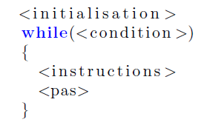
Conversion for → while
You can convert a for loop into a while loop by doing this:

Slide 11
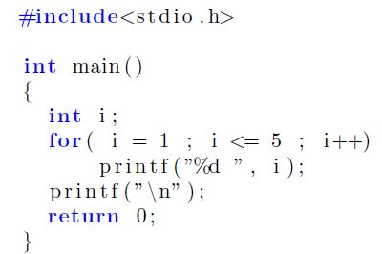
for
We re-write the display of the first 5 integers in this way using the fact that <initialization> = i =1 , <condition> = i <= 5 and <step> = i++. We obtain :

Slide 12
Unnecessary braces
In the same way that you can remove braces around a statement in an if block, you can remove braces around the body of a loop if it contains only one statement.

Slide 13
LET’S SUMMARIZE

Slide 14
WHILE LOOP continued
/* while loop */
#include <stdio.h>
#define NUMBER 22
hand()
{
int count = 1, total = 0;
while(count <= NUMBER)
{
printf(“Long live the C language!!!\n”);
count++;
total += count;
}
printf(“Total is %d\n”, total);
}
Initialization
End of loop condition (loop while true)
( loop only if true )
Increment

Slide 15
DO WHILE LOOP continued
/* do while loop */
#include <stdio.h>
#define NUMBER 22
hand()
{
int count = 1, total = 0;
do
{
printf(“Long live the C language!!!\n”);
count++;
total += count;
} while(count <= NUMBER);
printf(“Total is %d\n”, total);
}
Initialization
Increment
End of loop condition (loop while true) ( loop done at least 1 time )

Slide 16
FOR LOOP continued
/* for loop */
#include <stdio.h>
#define NUMBER 22
hand()
{
int count, total = 0;
for(count =1; count <= NUMBER; count++, total += count)
printf(“Long live the C language!!!\n”);
printf(“Total is %d\n”, total);
}
Initialization
End of loop condition
Increment and other functions

