Slide 1
Hydraulics & Pneumatics

Slide 2
Chapter 01 :
Generality on the properties of Fluids

Slide 3
1/ Introduction
Fluid mechanics is the science that studies the flow of fluids (liquid and gas) when they are subjected to external forces. It is the basis for the dimensioning of fluid lines and fluid transfer mechanisms. Two cases can be distinguished :
- the statics of fluids , or hydrostatics which studies fluids at rest.
- fluid dynamics who studies fluids in motion.

Slide 4
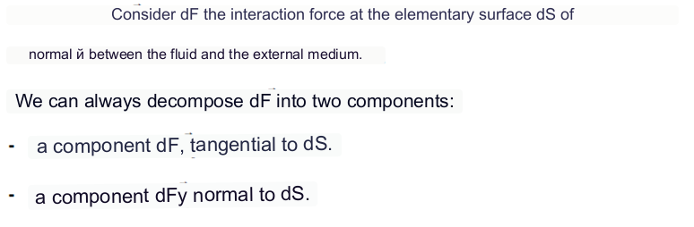
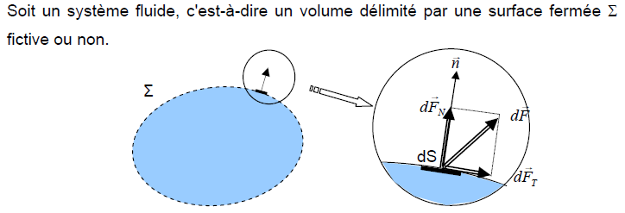
2/ Definition of liquids
A liquid is an assembly of material particles that move relative to each other .
Consider a fluid system, ie a volume delimited by a closed surface ∑.

Slide 5
Perfect fluid:
- A fluid is said to be perfect if it is possible to study its motion without taking into account the effects of friction .
- That is to say the Tangential component dFT is zero. In other words, the force dF is normal to the surface element dS .
Real fluid:
In a real fluid the tangential forces of internal friction are taken into consideration.
At rest, we will admit that the real fluid behaves like a perfect fluid, (The statics of real fluids merges with the statics of perfect fluids).

Slide 6
Incompressible fluid
A fluid is said to be incompressible when the volume occupied by a given mass does not vary according to the external pressure.
Liquids can be considered as incompressible fluids (water, oil, etc.).
Compressible fluid
A fluid is said to be compressible when the volume occupied by a given mass varies according to the external pressure. Gases are compressible fluids.
For example: air, hydrogen ,… are considered as compressible fluids.

Slide 7

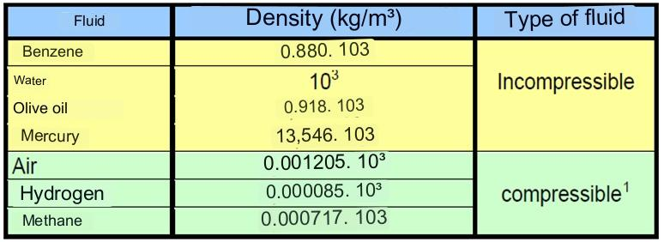
3/ Physical characteristics
3.1 . Density :
ρ : Density in ( kg/m3 ),
m: mass in (kg),
V : volume in (m3).
Examples:

Slide 8


3.2. Volume weight:
ϖ: Volume weight in (N/m3).
m: mass in (kg),
g: acceleration due to gravity in (m/s2 ),
V: volume in (m3).
3.3. Density :
In the case of liquids, water will be taken as the reference fluid .
In the case of gases we will take the air as reference fluid.

Slide 9
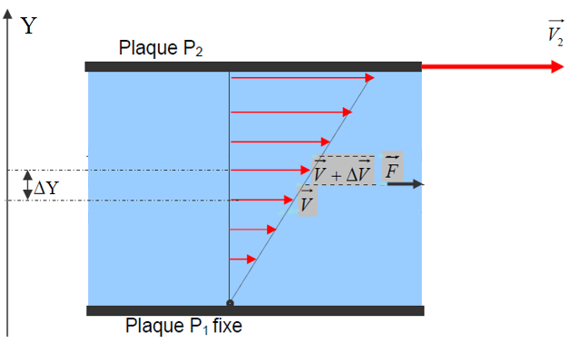
3.4 . Viscosity
It is a quantity that characterizes the internal friction of the fluid, in other words its ability to flow.
For example, if we consider a viscous fluid placed between two plates P1 and P2, such that the plate P1 is fixed and the plate P2 is driven by a speed V ₂ .
motion can be thought of as resulting from the sliding of fluid layers over each other.
- The speed of each layer is a function of the distance Y.

Slide 10

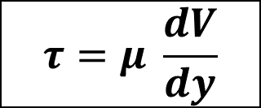
3.4.1 . Dynamic viscosity (Newton's law )
The dynamic viscosity expresses the proportionality of the frictional force F which is exerted on the surface of separation of two adjacent layers distant from Δ Y.
$$τ=μ \frac{dV}{dy}$$
F : sliding force between the layers in (N),
μ : Dynamic viscosity in (kg/ ms ),
S : contact surface between two layers in (m2),
dV : Velocity difference between two layers in (m/s),
there _ : Distance between two layers in (m).
( d V / dy ): Strain rate.
1 Pa⋅s = 1 Poiseuille (Pl) = 1
Dynamic viscosity corresponds to the physical reality of the behavior of a fluid subjected to stress (force).

Slide 11

3.4.2 . Kinematic viscosity
The kinematic viscosity characterizes the flow time of a liquid.
The unit of kinematic viscosity is the (m ² /s) or the Stokes (St).
1 St= 10 ⁻⁴ m ² /s

Slide 12
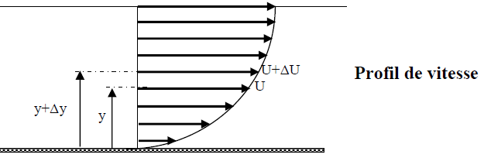
a/ Velocity profile in a cylindrical tube:
Under the effect of the interaction forces between the fluid particles and the interaction forces between the fluid particles and those of the wall, each fluid particle does not flow at the same speed. We say that there is a velocity profile ( figure).
Let us consider two adjacent layers of fluid distant from Δy , the force of friction F which is exerted on the surface of separation of these two layers opposes the sliding of a layer on the other . It is proportional to the difference in speed of the layers, i.e. ΔU, to their surface S and inversely proportional to Δy :

Slide 13
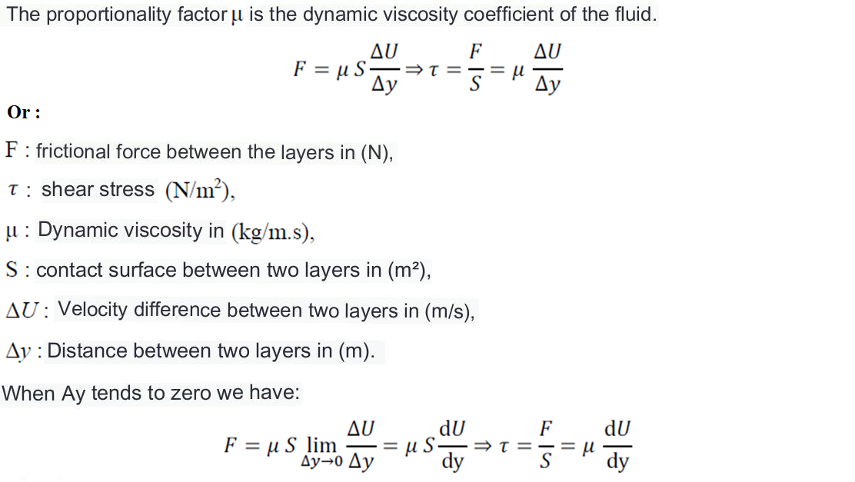

Slide 14
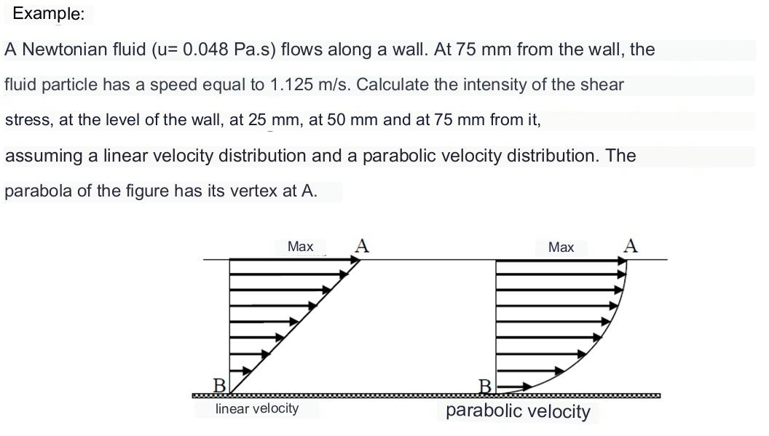

Slide 15
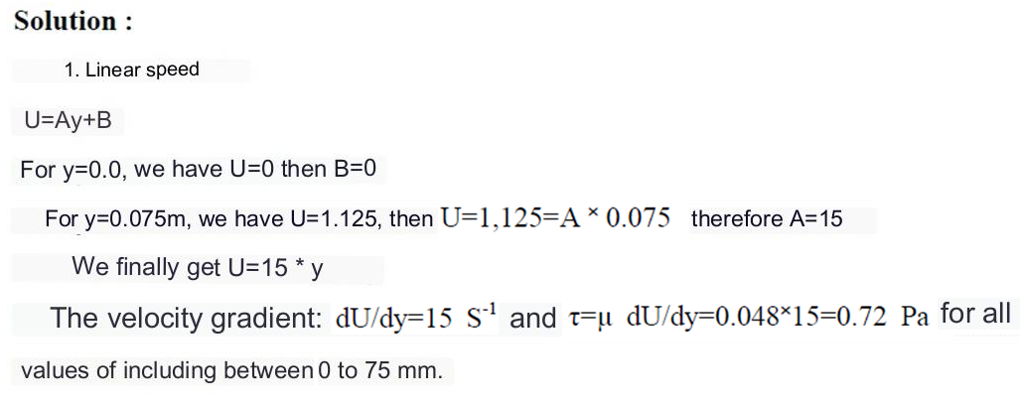

Slide 16
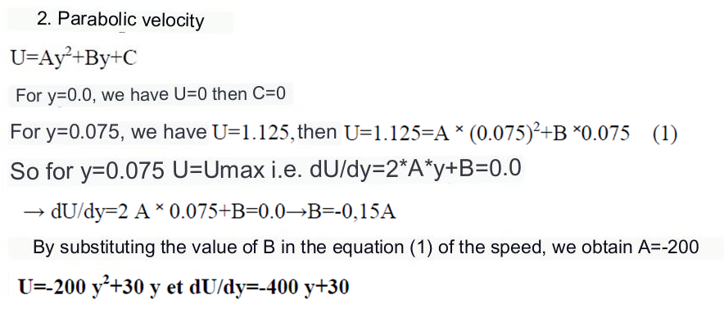
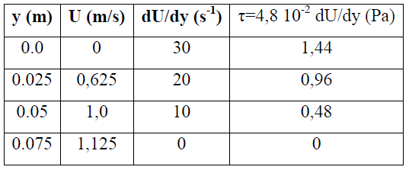

Slide 17
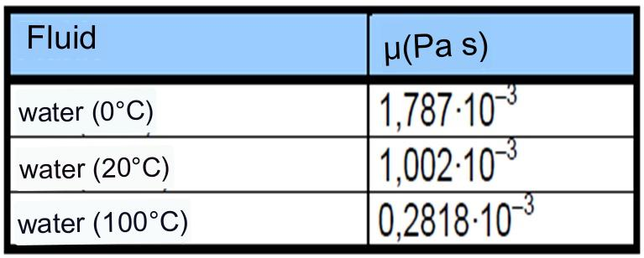
5 . Variation in viscosity as a function of T°:
- When the temperature increases, the viscosity of a liquid decreases because its density decreases.
Example :

Slide 18
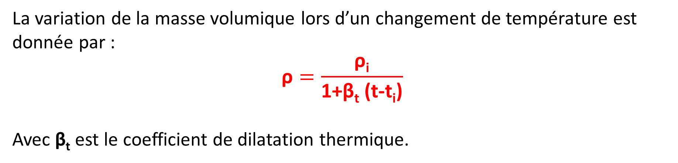
6. Density variation as a function of T°:
The variation of the density during a change of temperature is given by :
$$\text{ρ}=\frac{\text{ρ}\text{i}}{\text{1+}\text{βt}\text{ (}\text{t}\text{−}\text{ti}\text{)}}$$
With β _{t} is the coefficient of thermal expansion .

Slide 19
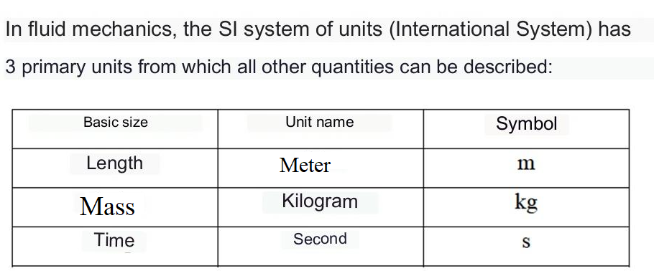
7. The SI System of Units:

Slide 20
