Slide 1

Chapter 2: Statics of Fluids
(Pressure force & Archimedes thrust)
Ministry of Higher Education and Scientific Research
University of Science and Technology of Oran Mohammed Boudiaf
(USTO-MB)
Course : Licence
Speciality: Electromechanical
Year: 2022-2023
Dr . SLIMANE Abdelkader

Slide 2
1. INTRODUCTION
During a scuba dive, we find that the water pressure increases with depth.
The water pressure at the bottom of a dam is greater than near the surface. The effects of pressure must be taken into consideration when dimensioning structures such as dams, submarines, reservoirs …
2. Assumptions
In this chapter, we consider that:
The studied fluids are at rest and in equilibrium.
No friction between the molecules of the fluid (the fluid is assumed to be perfect).

Slide 3

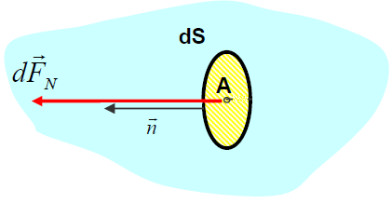
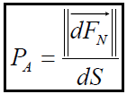
3. CONCEPT OF PRESSURE AT A POINT OF A FLUID
The pressure represents the intensity of the normal component of the force exerted by the fluid on the unit area.
dS : Elementary surface of the facet with center A (in square meter),
n: Unit vector of the normal in A,
dF : Normal component of the elementary pressure force.
P A : pressure at point A (in Pascal),
Explanation : Each cm² surface of our skin supports about 1 kg (force) representing the weight of the atmosphere. It is the atmospheric pressure at sea level.

Slide 4
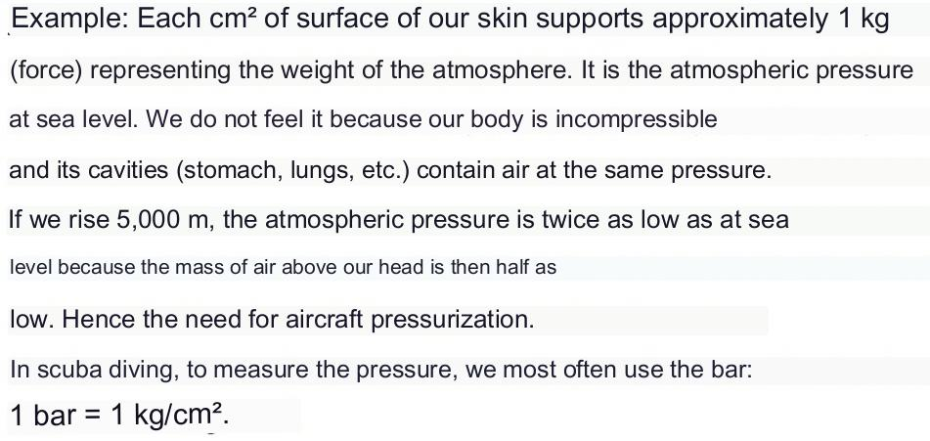
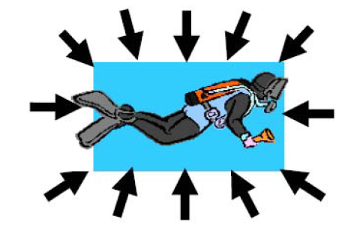

Slide 5
3.1. Pressure units
Pascal (N/m²), MPa (N/mm²), Bar, atmosphere .
1 [ bar ] = 10 ⁵ [Pa]
1 [ atm ] = 1.01325 10 ⁵ [Pa]
1 [ atm ] = 1.01325 [bar]
1 [bar] = 1 kgf /cm ² , (1 kgf = 9.81N)

Slide 6
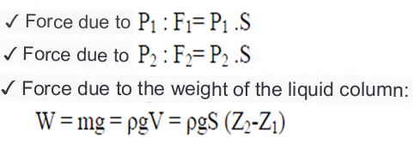
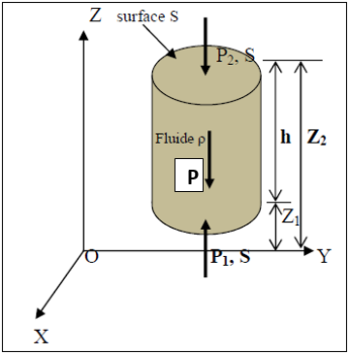

4. Fundamental relationship of hydrostatics
We consider a fluid element of density ρ representing a cylindrical vertical column of constant cross-section S .
The equilibrium condition is then written :
SO :
And therefore the law of the statics of fluids is given by:

Slide 7
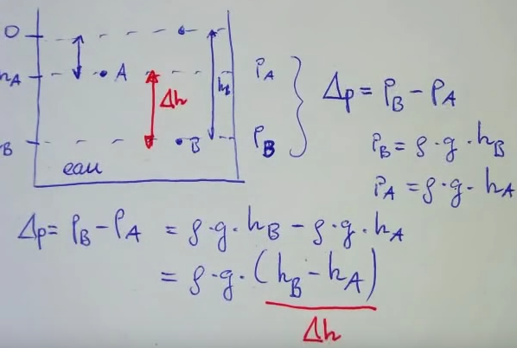
4.1. Difference in pressure between two points of a liquid

Slide 8
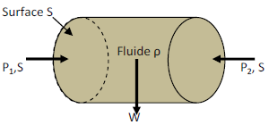

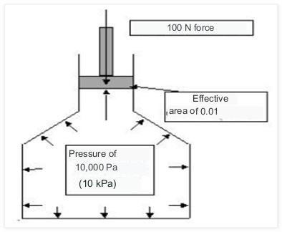
4.2. The pressures on the horizontal plane:
We conclude that: On the same horizontal plane ,
all pressures are equal (therefore Isobaric Pressures).
5 . PASCAL 'S THEOREM :
In the 17th century, Blaise Pascal enunciated a law:
"At rest, the pressure of a fluid at a point is
the same in all directions.

Slide 9
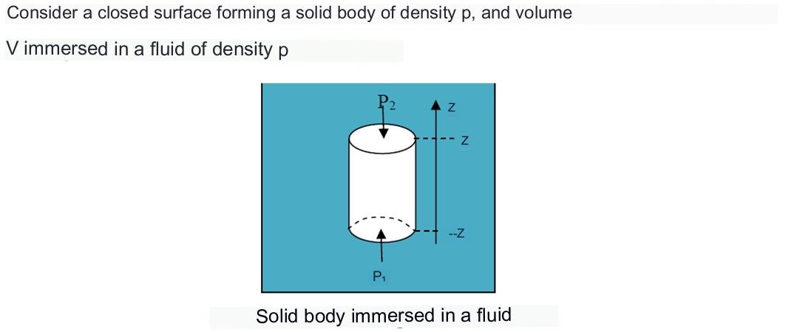
6. Archimedes push

Slide 10
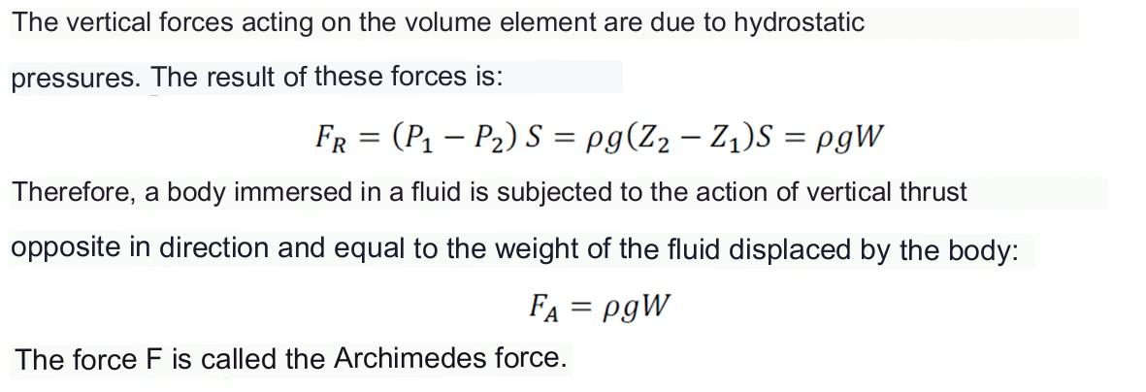

Slide 11
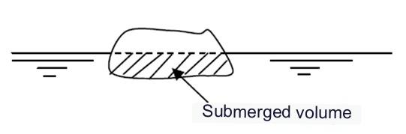
Archimedes' theorem :
Any body immersed in a fluid receives from this fluid a vertical force (thrust) , upwards, the intensity of which is equal to the weight of the volume of fluid displaced ( this volume is therefore equal to the submerged volume of the body ). It follows from this theorem that if the weight of a body placed in a fluid mass is
less than the weight of its fluid volume, the body floats .
Example :
What is the volume fraction of a piece of solid metal with specific gravity 7.25 floating on the surface of a container of mercury with specific gravity 13.6.

Slide 12
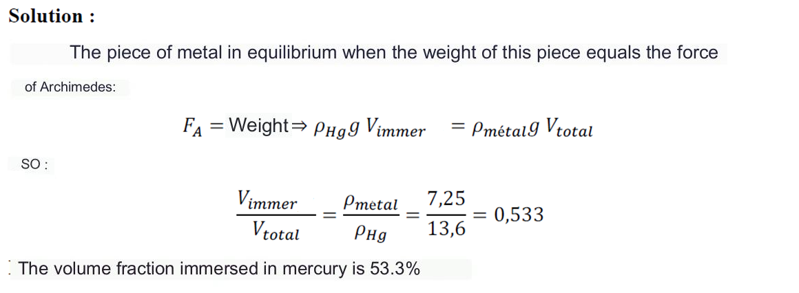

Slide 13
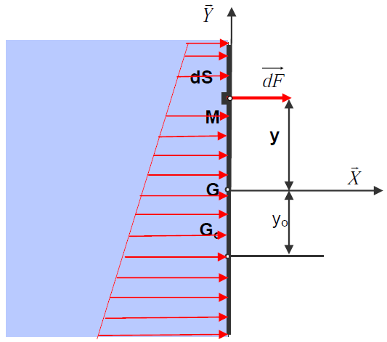
7. Force of pressure on the walls:
This force is defined as being the pressure force exerted by a fluid at rest on a contact surface, this force is always normal to the surface. The calculation of the hydrostatic forces on any surface immersed in water consists in determining the intensity of the force and its point of application.
Hypotheses
The vertical wall has an axis of symmetry ( G, Y ). G is its center of area .
On one side of the wall there is a fluid of density ϖ , on the other side there is air at atmospheric pressure P atm . We denote by PG the pressure at the center of surface G on the fluid side.

Slide 14
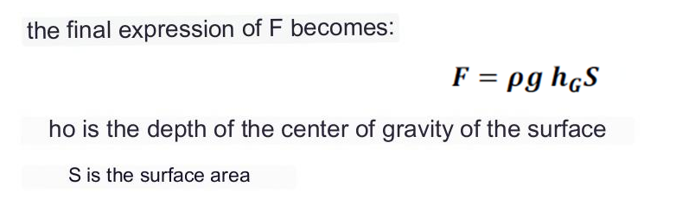
Consider a surface element of the plate ≪ dS ≫, the pressure exerted on this element is :
P =ρ g h
The point of application of the resultant force F is called : the center of thrust.

Slide 15
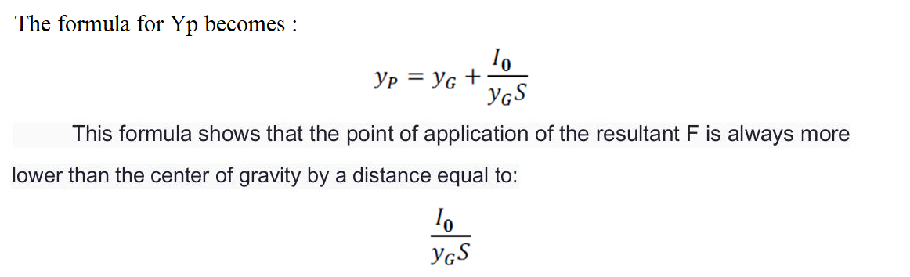

Slide 16
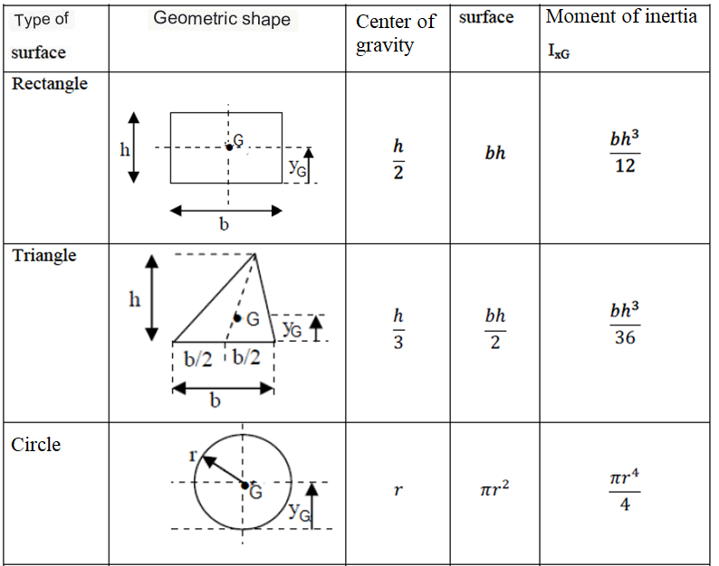
The following table provides this flat surface :

Slide 17
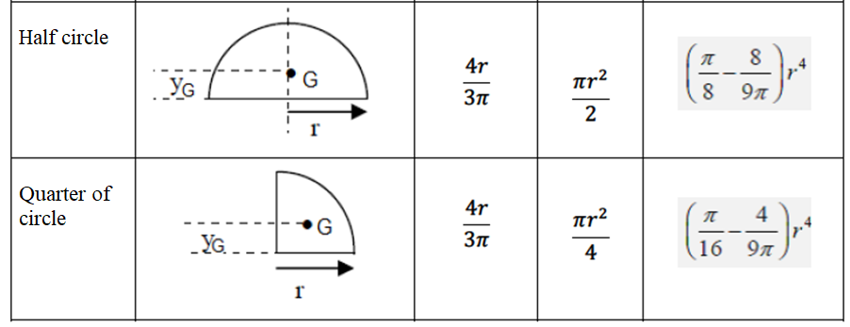

Slide 18
