Slide 1
DYNAMICS OF PERFECT INCOMPRESSIBLE FLUIDS
Chapter 3:

Slide 2
1/ INTRODUCTION
Dynamics means fluids in motion . Unlike solids, moving parts of a fluid can move at different speeds.
We use the equations that govern the dynamics of perfect incompressible fluids:
- The continuity equation (conservation of mass),
- Bernoulli's theorem (conservation of energy),
- Euler's theorem (conservation of momentum).

Slide 3
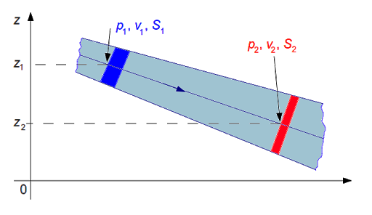
2/ PERMANENT FLOW
The flow of a fluid is said to be permanent if the field of velocity vectors of the fluid particles is constant at time t.

Slide 4
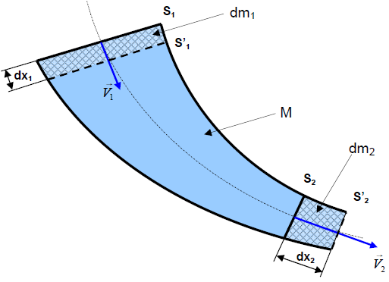
3/ CONTINUITY EQUATION
Consider a vein of an incompressible fluid
of density ρ animated by a permanent flow.
S1 and S2 respectively the input section and
the fluid outlet section at time t,
S'1 and S'2 respectively the sections
entry and exit of the fluid at time t'=( t+dt ),
V1 _ and V2 _ flow velocity vectors.
dx1 and dx2 : respectively the displacements
sections S1 and S2 during the time interval dt ,
dm1: incoming elementary mass between sections S1 and S'1,
dm2: outgoing elementary mass between sections S2 and S'2,
dV1 : incoming elementary volume between sections S1 and S'1,
dV2: outgoing elementary volume between sections S2 and S'2,

Slide 5
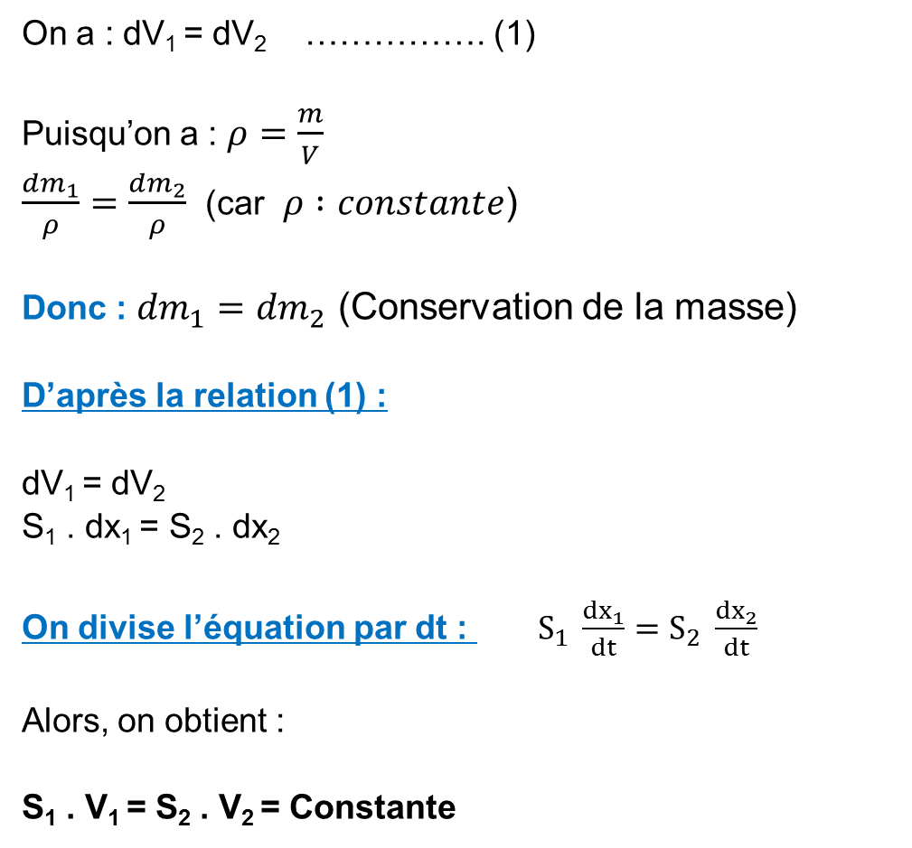
We have: dV ₁ = dV ₂ ……………. (1)
Since we have:$ρ=\frac{m}{V}$
$\frac{{dm}_{1}}{ρ}=\frac{{dm}_{2}}{ρ}$(because $ρ :constante$)
So: ${dm}_{1}={dm}_{2}$(Conservation of mass)
According to relation (1):
dV1 = _{dV2}
S1 . _ dx ₁ = S ₂ . dx ₂
We divide the equation by dt :$S_{1} \frac{{dx}_{1}}{dt}=S_{2} \frac{{dx}_{2}}{dt}$
So, we get:
S1 . _ V ₁ = S ₂ . V ₂ = Constant

Slide 6


Slide 7


4/ CONCEPT OF THROUGHPUT
4.1/ Volume flow
Volume flow is the ratio of volume flow per unit time.
noting that: dV =S. dx we can also write that:
$$Q_{V}=\frac{dV}{dt}$$

Slide 8

4.2/ Mass flow
It is the mass of fluid per unit time:
( Relation between Qm and Qv )

Slide 9
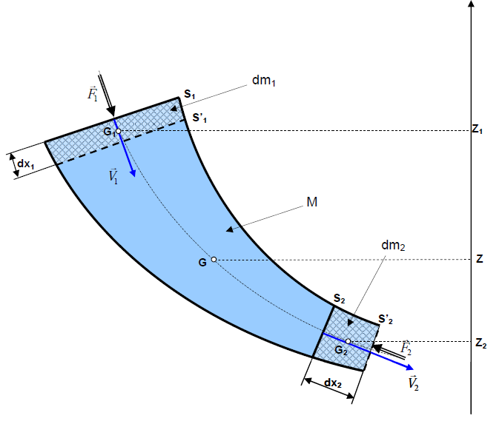
5/ BERNOULLI'S THEOREM – CASE OF A FLOW WITHOUT EXCHANGE OF WORK
Let us take again the diagram of the fluid vein of paragraph 3 with the same notations and the following assumptions:
- The fluid is perfect and incompressible.
- The flow is permanent.
- The flow is in a perfectly smooth pipe .
We consider a vertical Z axis directed upwards.
We note Z 1 , Z 2 and Z respectively the altitudes of the centers of gravity of the masses
dm 1 , dm 2 and M.
We denote by F 1 and F 2 respectively the norms of the pressure forces of the
fluid acting at the level of the sections S 1 and S 2 .

Slide 10


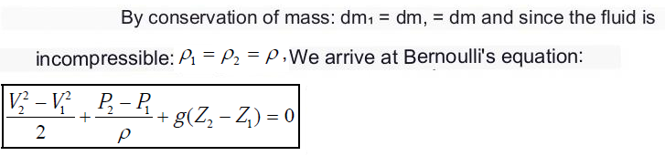
At time t the mass fluid (dm1 + M) is between S1 and S2. Its mechanical energy is:
At time t'=( t+dt ) the fluid of mass (M+dm 2 ) is between S' 1 and S' 2 . Its mechanical energy is:
We apply the mechanical energy theorem to the fluid between t and t': “ The variation of the mechanical energy is equal to the sum of the works of the external forces . »

Slide 11
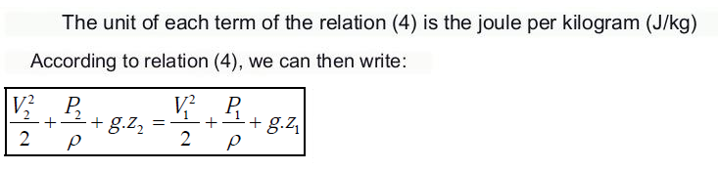

Slide 12
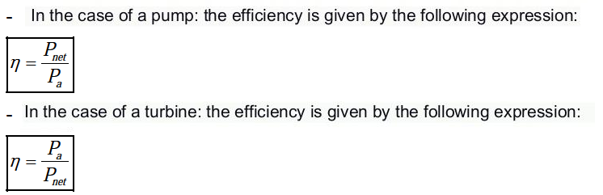
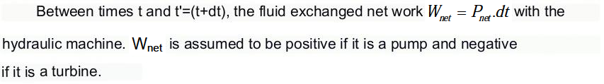
6/ BERNOULLI'S THEOREM – CASE OF A FLOW WITH EXCHANGE OF WORK
It is further assumed that a hydraulic machine is placed between the sections S 1 and S 2 . This machine is characterized by a net power Pnet exchanged with the fluid, a power on the shaft Pa and a certain efficiency η . This machine can be either a turbine or a pump .

Slide 13
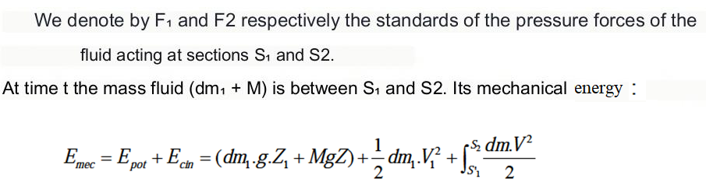
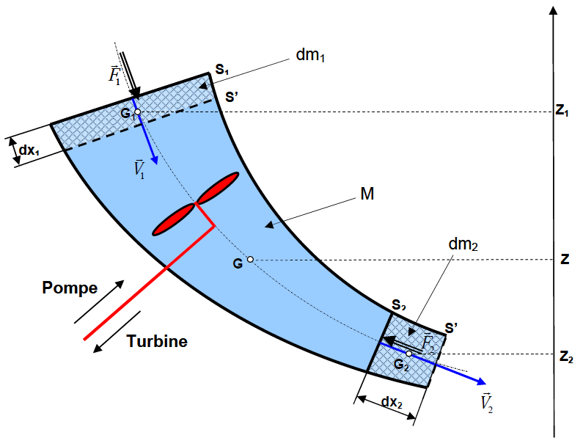


Slide 14
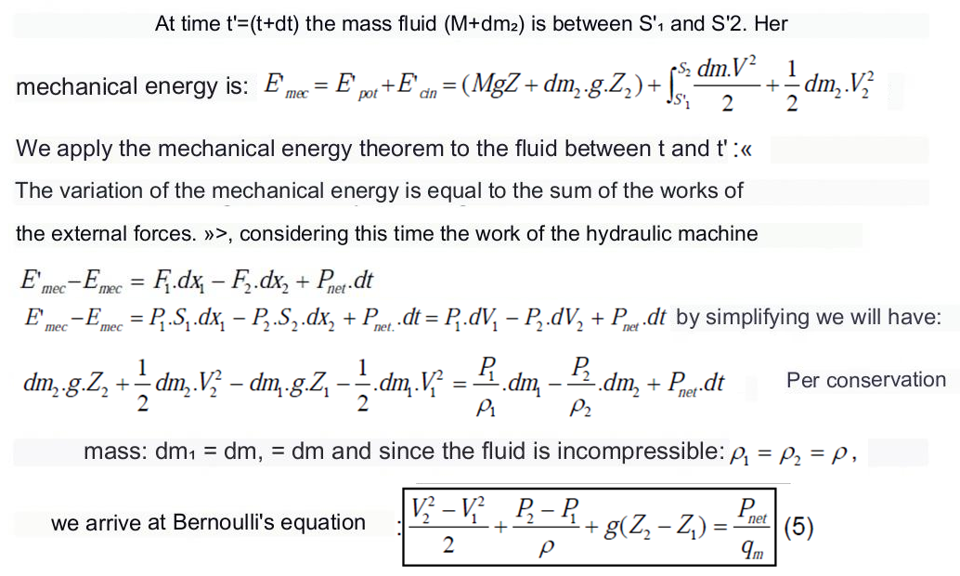

Slide 15



Momentum ( EULER'S THEOREM )
This theorem makes it possible to determine the forces exerted by the moving fluid on the objects which surround them .
Euler's theorem results from the application of the momentum theorem to the flow of a fluid:

