Slide 1
DYNAMICS OF REAL INCOMPRESSIBLE FLUIDS
Chapter 4:

Slide 2
1/ INTRODUCTION
In the previous chapter we assumed that the fluid was perfect to apply the energy conservation equation.
In the case of the flow of a real fluid, it There are frictional forces , due to the viscosity of the fluid, which act between the fluid particles and the walls, as well as between the particles themselves .
2/ REAL FLUID
A fluid is said to be real if, during its motion, the contact forces are not perpendicular to the surface elements on which they are exerted . This resistance is characterized by the viscosity.

Slide 3
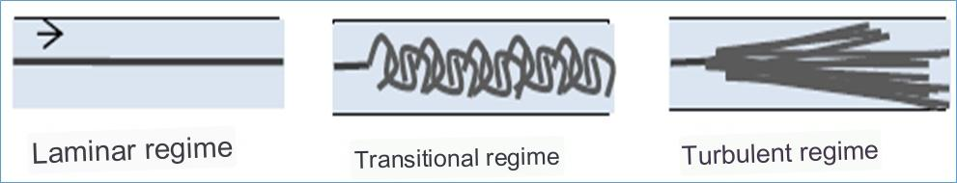
3. FLOW REGIMES - R EYNOLDS NUMBER
Reynolds (1883) varied the flow rate, viscosity and diameter of the pipe, and If a small volume of dye is injected into the axis of a horizontal pipe through which water flows, the following phenomena are observed according to the flow rate of the liquid:
Re < 2000 2000< Re <3000 Re > 3000

Slide 4


Reynolds number: is a dimensionless number used to determine the flow regime.
v : Average speed
ʋ: kinematic viscosity
μ: dynamic viscosity
D: Pipe diameter
ρ:density
If Re <2000 the regime is laminar
If 2000< Re <3000 the regime is transient
If Re >3000 the regime is turbulent

Slide 5
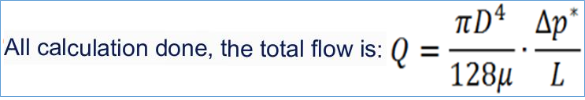
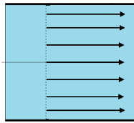
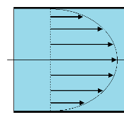
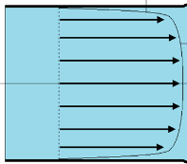
3.1. Speed profile
Perfect
laminar
Turbulent

Slide 6
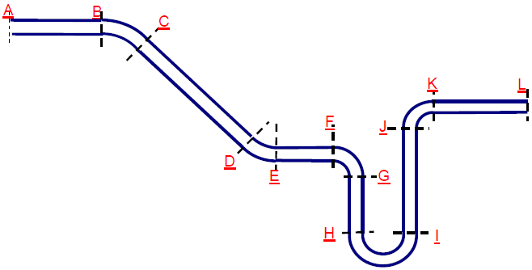

4. Load losses
4.1. Singular pressure drops
The existence of head losses results in the sudden change in direction and/or section (fitting, T, valves, etc.) .
ΔHs
K : Head loss coefficient (unitless). It depends on nature and geometry.
The values of K are given by the manufacturers in their catalogues.

Slide 7
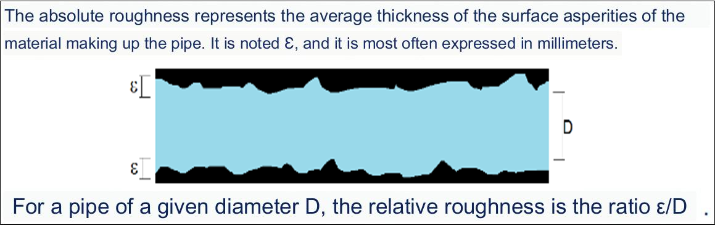
4.2 Linear head losses:
They then correspond to the flow along the pipes due to the roughness of the pipe.

Slide 8
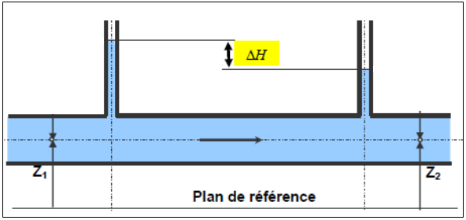


4.2 Linear head losses:
They then correspond to the flow along
pipes due to the roughness of the pipe.
ΔH l
- V: average flow velocity in the pipe (m/s)
- L: length of the pipe (m)
- d: pipe diameter (m)
- λ : linear pressure drop coefficient (is the coefficient of friction). It depends on the flow regime and in particular on the Reynolds number Re .

Slide 9
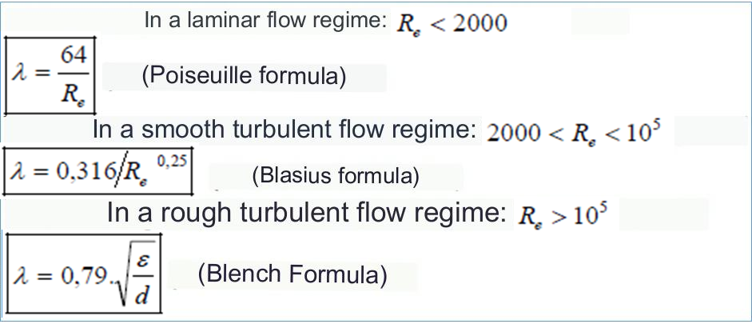
ΔHl

Slide 10
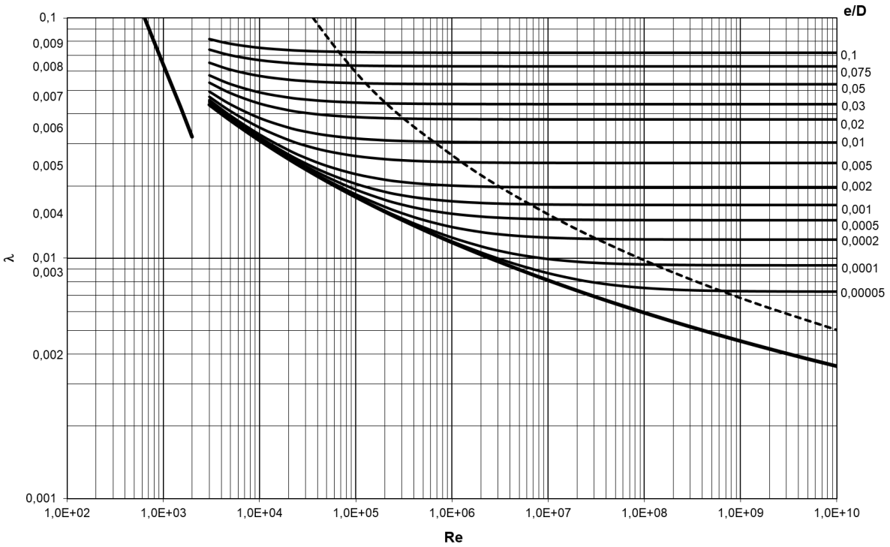
Sometimes, we read the value of λ on an abacus established by Moody.
ΔHl

Slide 11
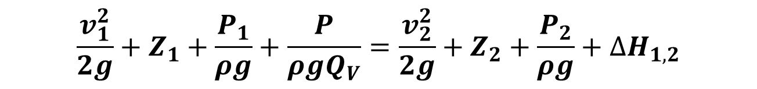
5. B ERNOULLI'S THEOREM APPLIED TO A REAL FLUID
Δ H 1.2 : Sum of all head losses, singular and linear between sections 1 and 2.
P: Mechanical power exchanged between the fluid and the machines placed between (1) and (2).
Bernoulli's Theorem takes the following general form:
$$\frac{v_{1}^{2}}{2g}+Z_{1}+\frac{P_{1}}{ρg}+\frac{P}{ρgQ_{V}}=\frac{v_{2}^{2}}{2g}+Z_{2}+\frac{P_{2}}{ρg}+{∆H}_{1,2}$$

