Slide 1
THE Character strings
C PROGRAMMING
Mr R. TLEMSANI

Slide 2
introduction
Given the program whose execution is traced below:
Enter a sentence:
The raspberries are perched on my grandfather's stool.
You entered:
The raspberries are perched on my grandfather's stool.
This sentence begins with a capital letter.
This sentence ends with a period.
How do I enter and manipulate character sequences like this?

Slide 3
Definition
A string is a char array containing a null character .
The null character has 0 for ASCII code and is written '\0'. The significant values of the character string are all those placed before the null character.
We therefore notice that if the null character is in the first position , we have an empty character string .

Slide 4
Definition
For example, the sentence "Toto" will be coded as follows:
Take note of the fact that the last character of the string is followed by a null character.
'T' | 'o' | 't' | 'o' | 0

Slide 5
Statement
As a character string is an array of chars, we declare it:
tank <string name>[<string size>];
For example, we declare a string c of 200 characters like this:
char c[200];
Attention !
The maximum number of letters that it will be possible to place in c will certainly not be 200 but 199 , because a null character must be placed after the last character of the string!

Slide 6
Initialization
We initialize a string at the declaration, and only at the declaration as follows:
char <string name>[<string size>] = <initialization value>;
Where the initialization value contains the juxtaposition of characters forming the string surrounded by quotation marks (double quotes).
For example, char c[50] = "Toto";
This instruction declares a character string c initialized to "Toto". The first 5 elements of the array will be occupied by the 4 characters of the string as well as the null character, the others will contain insignificant values. Take a good look at the following example:
char c[4]="Toto";
This declaration will generate a warning at compilation and probably an error at runtime because the assignment of the null character to the 5th ^{position} of the array will give rise to an index overflow .

Slide 7
Access to elements
Since a string is an array, it is easy to isolate an element. So it[i] is the
i+1 ^{th} element of string c. We therefore test if the first character of c is a capital letter like this:
if( c [ 0 ] >= 'A' && c [ 0 ] <= 'Z ' )
printf ("This sentence starts with a capital letter .\n" );
else
printf ( "This sentence does not start with a capital letter. \n" );
This property also allows you to display a string character by character:
int i = 0;
while (c[i] != 0)
printf("%c “,c[i++]);

Slide 8
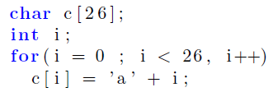
Access to elements
Note that the body of the while loop is iterated until the null character is encountered . So it is imperative that your string is null-terminated and that the null character is within the index range of the array.
Is the following code correct?

Slide 9
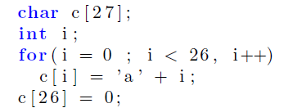
Access to elements
If you are asked the question, you can assume that this code is not correct.
Note that the array contains 27 elements if we count the null character, and that this is placed at the end of the array just after the loop.

Slide 10
Display
We saw that it was possible to use the fact that a string is an array to display it. There is a simpler method, using printf with the format string "%s". On the other hand, be careful of the fact that if your string does not contain a null character or if the null character is outside the index range of your string, you will have to expect the worst horrors at execution!
In the example code we can therefore write the instruction to display the string entered by the user:
Printf(“You entered: \n %s” , c );

Slide 11
Seizure
Now things get tricky, you have to be very careful when making entries: any overflow of indices and/or absence of null characters can give rise to bugs that are very difficult to find! The greatest vigilance is therefore required.
Many enthusiasts use functions like gets . For example,

Slide 12
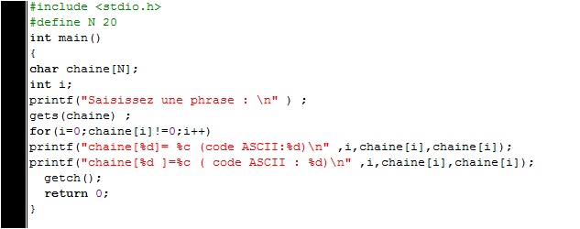
Seizure
Now things get tricky, you have to be very careful when making entries: any overflow of indices and/or absence of null characters can give rise to bugs that are very difficult to find! The greatest vigilance is therefore required.
Many enthusiasts use functions like gets . For example,

Slide 13
Seizure
The response from some compilers is an insult. They display: warning: the `gets' function is dangerous and should not be used.
Now, we'll consider a clean way to enter a string: fgets . The syntax is as follows:
fgets(<string>, <size>, stdin);
We will therefore enter the sentence of our program like this:
fgets(c,200,stdin);

Slide 14
The string.h library
This library offers functions for handling character strings, namely:
strcmp: compare two strings.
strlen: length of a character string
strsubs: search for a substring
strcat: concatenate two strings
strcpy: copy a string

Slide 15
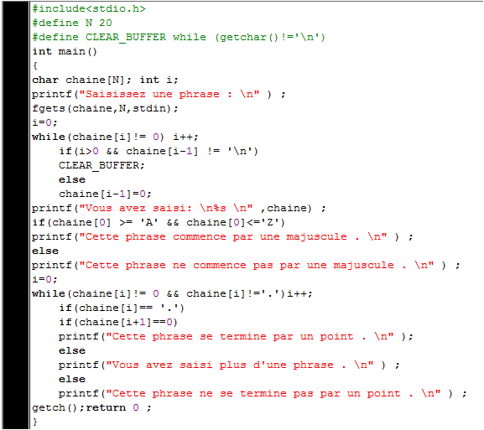
Example

