Slide 1
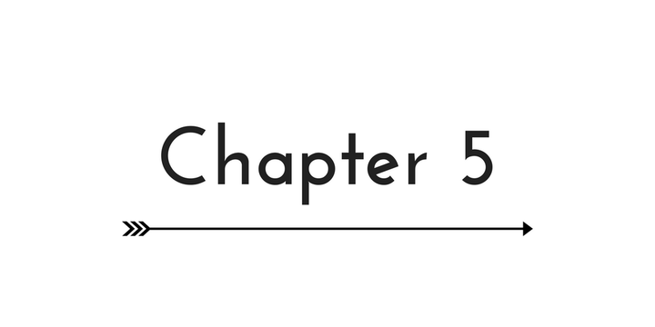
Making Decisions

Slide 2
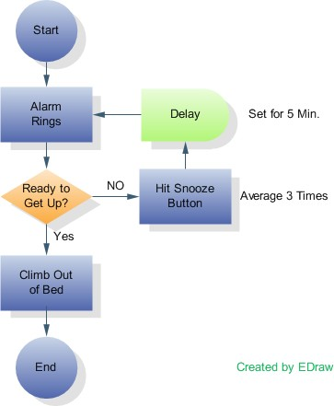
Flow of Control
Flow of control
TraThe order in which statements are executed
nsfer of control
When the next statement executed is not the next one in sequence

Slide 3
Flow of Control
Control structures
combination of individual statements into a logical unit that regulates the flow of execution in a program or function
Sequence
Selection (Making Decisions)
Repetition (Looping)

Slide 4
Boolean Expressions
Evaluate to true or false
Forms
Relational expression: <expr> <relational operator> <expr>
Examples:
7 < 5
a + b > 6
Logical expression: <Boolean expr> <logical operator> <Boolean expr>
Examples:
(x < 7) && (y > 3)

Slide 5
Relational Operators
Standard Algebraic Relational Operator | C Relational Operator | C Condition Example | Meaning of C Condition
Inequality
< | < | x < y | x is less than y
≤ | <= | x <= y | x is less than or equal to y
> | > | x > y | x is greater than y
≥ | >= | x >= y | x is greater than or equal to y
Equality
= | == | x == y | x is equal to y
≠ | != | x != y | x is not equal to y
4th: Ch 4 p. 46
3rd: Ch 5 p. 46

Slide 6
Logical Operators (Compound Relationals)
&& (logical AND)
Returns true if both conditions are true
|| (logical OR)
Returns true if either of its conditions is true
! (logical NOT, logical negation)
Is a unary operator, only takes one operand following
Reverses the truth/falsity of its condition
Returns true when its condition is false

Slide 7
Logical Operators Truth Table
P | Q | P && Q | P || Q | !P
true | true | true | true | false
true | false | false | true | false
false | true | false | true | true
false | false | false | false | true

Slide 8
Precedence of Operators
1. (), []
2. Unary +, unary -, !, ++, --
3. Type casting
4. * , / , %
5. + , -
6. <, <=, >, >=
7. ==, !=
8. &&
9. ||
10. =

Slide 9
The if Selection Structure
Selection structure
used when we want the computer to choose between two alternative courses of action

Slide 10
The if Selection Structure
if Statement
Boolean Expression
true
false
true block

Slide 11
The if Selection Structure
General form of if:
if (Boolean Expression)
{
statement1;
statement2;
...
}

Slide 12
The if-else Selection Structure
if
Only performs an action if the condition is true
if-else
A different action is performed when condition is true and when condition is false

Slide 13
if-else Selection Structure
if-else statement
false
true
Boolean
Expression
false block
true block

Slide 14
The if-else Selection Structure
General form of if-else:
if (expression)
{
statement1A; statement2A;
...
}
else
{
statement1B;
statement2B;
...
}

Slide 15
The if-else Selection Structure
Nested if-else structures
Test for multiple cases by placing if-else selection structures inside if-else selection structures.

Slide 16
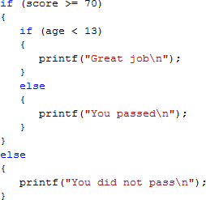
Nested if-else Structures

Slide 17
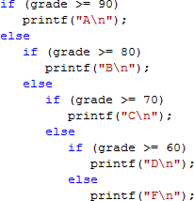
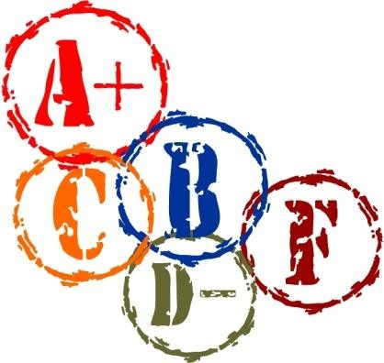
The if-else-if Construct
Once a condition is met, the rest of the statements are skipped

Slide 18
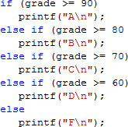
The if-else-if Construct
The standard way to indent the previous code is

Slide 19
The if-else Selection Structure
Compound statement:
Set of statements within a pair of braces
Example:

Slide 20
The if-else Selection Structure
–Without the braces, only one statement is executed.
e.g. given the following code:
The statement,
will be executed independent of the value of grade.
The statement,
will execute only if grade is greater than or equal to 90.

Slide 21
The dangling else
Note: the compiler matches an else with the closest unmatched if The above will be treated as

Slide 22
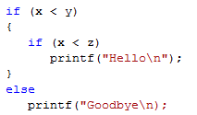
The dangling else
If the else is to match the outer if, use braces.

Slide 23
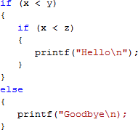
if-else Construct
To avoid confusion, and possible errors, it is best to use braces even for single statements.
However, code will be longer

Slide 24
Conditionals
C uses an integer to represent Boolean values
Zero is interpreted as false
Any other integer value is interpreted as true

Slide 25
Conditionals
▪
is not a syntax error in C.
The expression, n = 0, assigns zero to n and the value of the expression is 0. Zero is interpreted as false, and the false branch of the if statement will be taken.
▪
is not a syntax error in C.
The expression assigns 5 to n. 5 is interpreted as true, and the true branch of the if statement will be taken.

Slide 26
Conditionals
Remember to use the == operator to test for equality.
To help catch the error when the equality check involves a constant, put the constant on the left hand side of the ==.
For example, use
instead of
Since is not a valid assignment in C, the compiler will detect this error when == is intended.

Slide 27
The switch Multiple-Selection Structure
switch
Useful when variable or expression is tested for multiple values
Consists of a series of case labels and an optional
default case

Slide 28
The switch Multiple-Selection Structure With Breaks
case a
case a action(s)
break
case b
case b action(s)
break
case z
case z action(s)
break
default action(s)

Slide 29
The switch Multiple-Selection Structure Without Breaks
case a
case a action(s)
case b
case b action(s)
case z
case z action(s)
default action(s)

Slide 30
switch Statement Syntax
switch (switch_expression)
{
case constant1:
statementSequence1 break;
case constant2:
statementSequence2
break;
…
case constantN:
statementSequenceN
break;
default:
defaultStmtSequence
}

Slide 31
switch Statement
The switch_expression is compared against the values
constant1, constant2, …, constantN
constant1, constant2, …, constantN must be simple constants or constant expressions.
Can be a char or an int
Best to use the same type constant as the switch expression
If not, a type conversion will be done.

Slide 32
switch Statement Reminder
The switch statement ends
break statement
end of the switch statement
When executing the statements after a case label, it continues to execute until it reaches a break statement or the end of the switch.
If you omit the break statements, then after executing the code for one case, the computer will continue to execute the code for the next case.

Slide 33
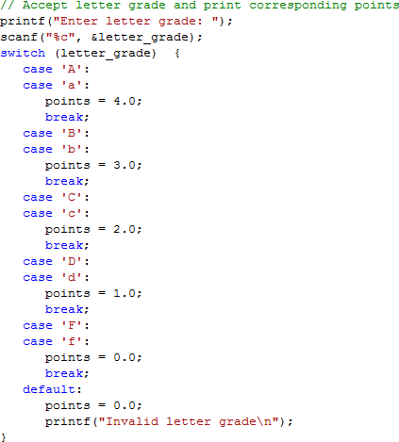
Example of
switch

