Slide 1
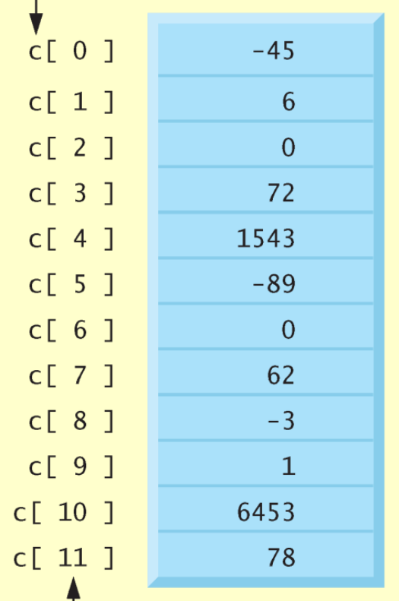
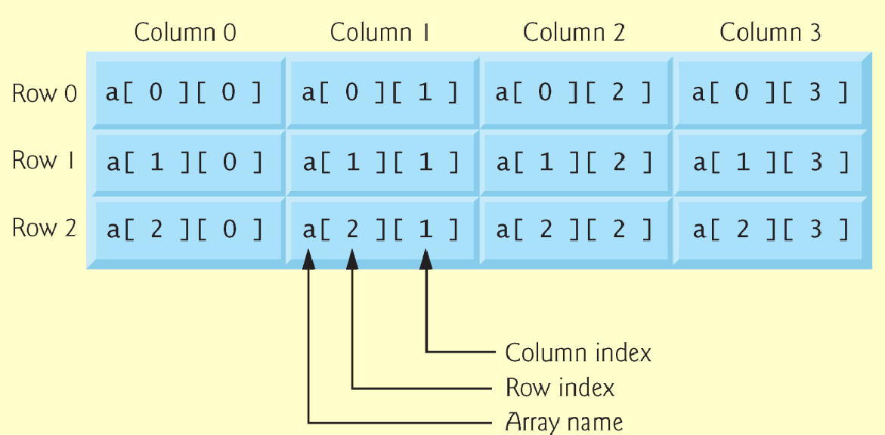
Programming in C

Slide 2
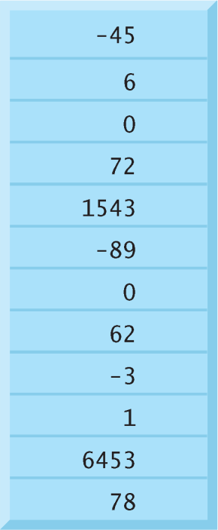
Introduction to Arrays
A collection of variable data
Same name
Same type
Contiguous block of memory
Can manipulate or use
Individual variables or
‘List’ as one entity
Celsius temperatures: I’ll name it c.
Type is int.

Slide 3
Introduction to Arrays
Used for lists of like items
Scores, speeds, weights, etc.
Avoids declaring multiple simple variables
Used when we need to keep lots of values in memory
Sorting
Determining the number of scores above/below the mean
Printing values in the reverse order of reading
Etc.

Slide 4
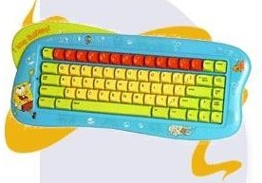
Declaring Arrays
General Format for declaring arrays
<data type> <variable> [<size>];
Declaration
Declaring the array → allocates memory
Static entity - same size throughout program
Examples
Type is int.
Name is c.

Slide 5
Defined Constant as Array Size
Use defined/named constant for array size
Improves readability
Improves versatility
Improves maintainability
Examples:

Slide 6
Powerful Storage Mechanism
Can perform subtasks like:
"Do this to i-th indexed variable" where i is computed by program
"Fill elements of array scores from user input"
"Display all elements of array scores“
“Sort array scores in order”
“Determine the sum or average score”
"Find highest value in array scores"
"Find lowest value in array scores"

Slide 7
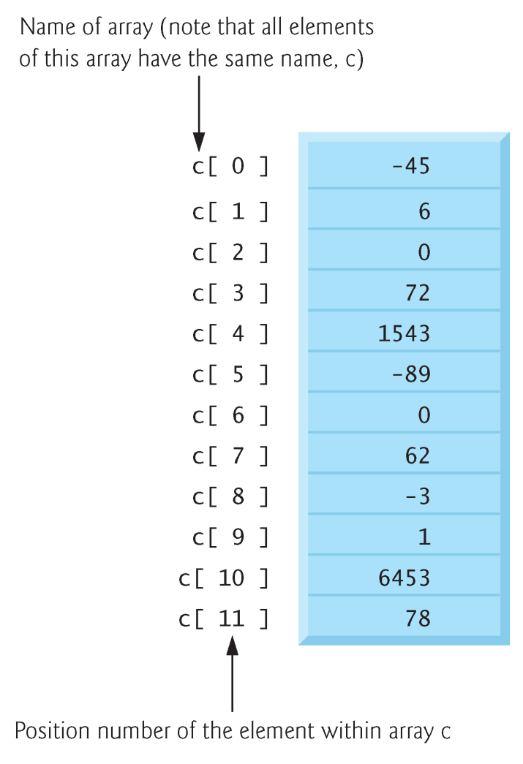
Accessing Array Elements
Individual parts called many things:
Elements of the array
Indexed or subscripted variables
To refer to an element:
Array name and subscript or index
Format: arrayname[subscript]
Zero based
c[0] refers to c₀, c sub zero, the first element of array c

Slide 8
Accessing Array Elements
Example
Note two uses of brackets:
In declaration, specifies SIZE of array
Anywhere else, specifies a subscript/index

Slide 9
Accessing Array Elements
Example
Given the declaration
We reference elements of scores by
scores [0]
scores [1]
…
subscript/index
scores [11]

Slide 10
Accessing Array Elements
Size, subscript need not be literal constant
Can be named constant or expression

Slide 11
Major Array Pitfall
Array indexes go from 0 through size-1!
C will 'let' you go out of the array’s bounds
Unpredictable results – may get segmentation fault
Compiler will not detect these errors!
Up to programmer to 'stay in bounds‘
?
?

Slide 12
for-loops with Arrays
Natural counting loop
Naturally works well 'counting thru' elements of an array
General form for forward direction
for (subscript = 0; subscript < size; subscript++)
General form for reverse direction
for (subscript = size-1; subscript >= 0; subscript--)

Slide 13
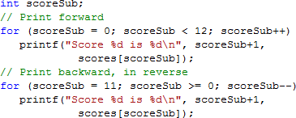
for-loops with Arrays Examples
Score 1 is 56
Score 2 is 52
Score 3 is 80
Score 4 is 74
...
Score 12 is 87
Score 12 is 87
Score 11 is 97
Score 10 is 86
Score 9 is 80
...
Score 1 is 56

Slide 14
Uses of Defined Constant
Use everywhere size of array is needed
In for-loop for traversal:
In calculations involving size:
When passing array a function:

Slide 15
Array as Function Parameter
Include type and brackets []
Size inside brackets is optional and is ignored
Passes pointer/reference to array
Function can modify array elements
Common to also pass size
Example:

Slide 16
Initializing Arrays
Arrays can be initialized at declaration
Size cannot be variable or named constant
Equivalent to

Slide 17
Auto-Initializing Arrays
If fewer values than size supplied:
Fills from beginning
Fills 'rest' with zero of array base type
Declaration
Performs initialization

Slide 18
Auto-Initializing Arrays
If array size is left out
Declares array with size required based on number of initialization values
Example:
Allocates array scores with size of 3

Slide 19
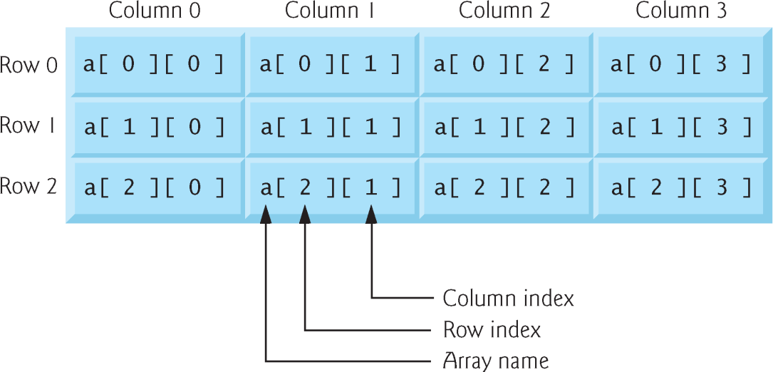
Multidimensional Arrays
Arrays with more than one dimension
Declaration: Additional sizes each enclosed in brackets
Two dimensions
Table or ‘array of arrays’
Requires two subscripts – row and column

Slide 20
Initializing Multidimensional
Nested lists
Unspecified values set to zero
2D Example:

Slide 21
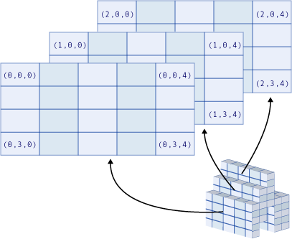
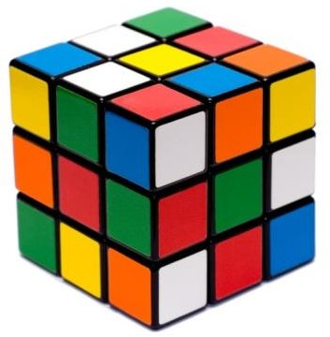
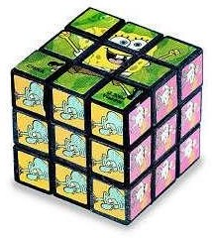
Three-dimensional Visualization

Slide 22
Multidimensional Array Parameters
Must specify size after first dimension

Slide 23
Programming in C
T H E E N D

