Slide 1
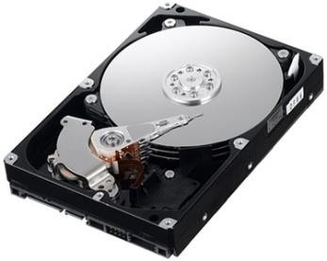
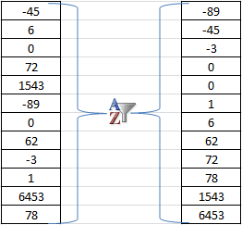
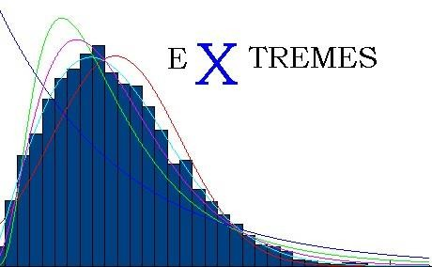
Programming in C

Slide 2
Programming with Arrays
Subtasks
Partially-filled arrays
Loading
Searching
Sorting
Sum, average
Extremes

Slide 3
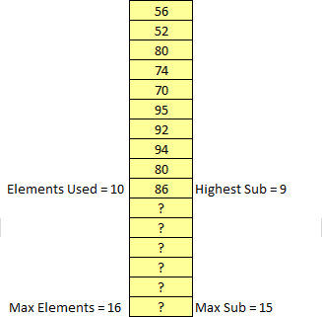
Partially-filled Arrays (Common Case)
Must be declared some maximum size
Program must maintain
How many elements are being used
and/or
Highest subscript

Slide 4
Sizeof and Arrays
Operator sizeof returns the total bytes in the argument
Total elements = sizeof(array) / sizeof(data-type)
⚫
Example
Sizeof does not return total bytes being used
You cannot use sizeof to determine the number of elements being used in a partially filled array

Slide 5
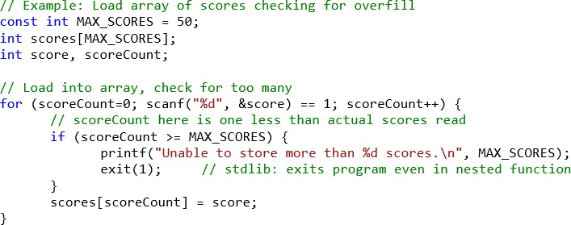
Loading an Array
Be careful not to overfill
Do not read directly into array elements

Slide 6
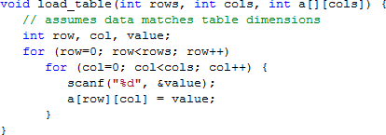
Loading a Two-dimensional Array

Slide 7
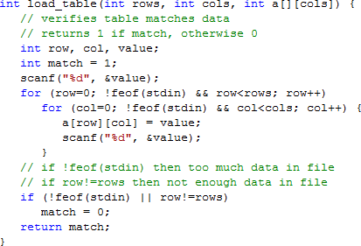
Safer 2D Load

Slide 8
Searching an Array
Linear search
Simple
Binary search
Requires sorted array
Generally faster for
large arrays
May require the use of an indicator to denote found or not found
74?

Slide 9
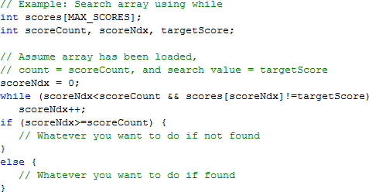
Linear Search Example Using While

Slide 10
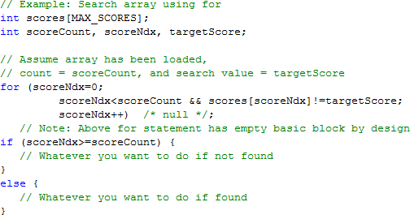
Linear Search Example Using For

Slide 11
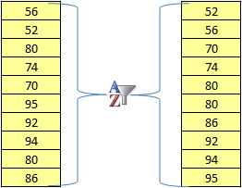
Sorting
Place array into some order
Ascending or descending
Many types
Simple: Selection
More intelligent: Bubble, selection, insertion, shell, comb, merge, heap, quick, counting, bucket, radix, distribution, timsort, gnome, cocktail, library, cycle, binary tree, bogo, pigeonhole, spread, bead, pancake, …

Slide 12
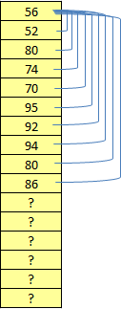
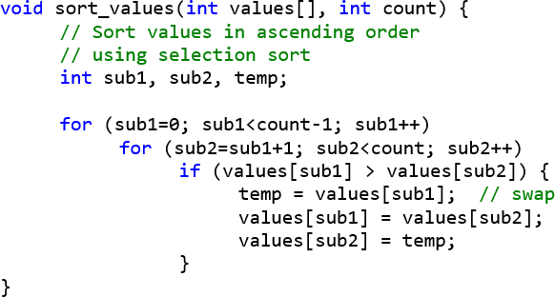
Selection Sort
Compare element to all elements below and then move to next element, swap when appropriate

Slide 13
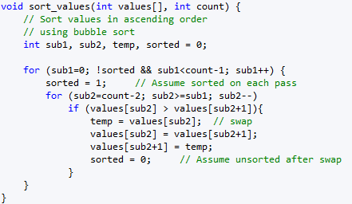
Bubble/Sinking Sort
Compare adjacent elements, swap when appropriate
Stop if no swaps on a pass

Slide 14
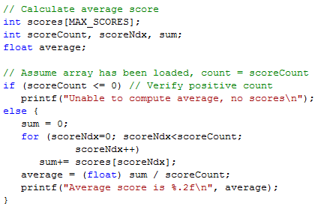
Sum & Average Example
Verify positive count before computing average
Protects against division by zero

Slide 15
Extremes
Same techniques as chapter 5 – best:
Assume first is extreme
Compare others to current extreme
Replace extreme when finding new extreme

Slide 16
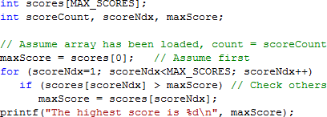
Extremes: Find Maximum Example

Slide 17
Programming in C
T H E E N D

