Slide 1
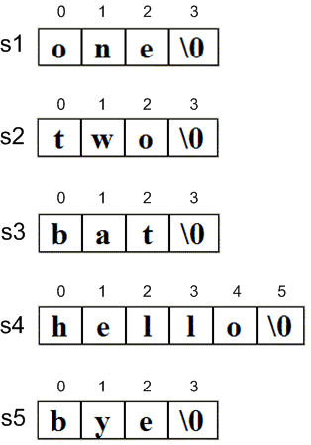
Programming in C

Slide 2
Strings
“Hello” is string literal constant
We’ve used strings
Array with base type char
One character per element
One extra character: '\0'
Called ‘null character’
End marker
Literal "Hello" stored as string

Slide 3
String Variable Declaration
Array of characters:
Declares a c-string variable to hold up to 9 characters plus one null character
No initial value

Slide 4
String Variable
Typically a partially filled array
Declare large enough to hold max-size string, including the null character.
Given a standard array:
If s contains string “Hi Mom!”, then stored as:

Slide 5
String Variable Initialization
Can initialize string:
Need not fill entire array
Initialization places '\0' at end

Slide 6
String Variable Initialization
Can omit array-size:
Automatically makes size one more than length of quoted string
NOT same as:
IS same as:

Slide 7
String Indexes
A string IS an array
Can access indexed variables of:
hi[0] is ‘H’
hi[1] is ‘i’
hi[2] is ‘\0’
hi[3] is unknown
hi[4] is unknown

Slide 8
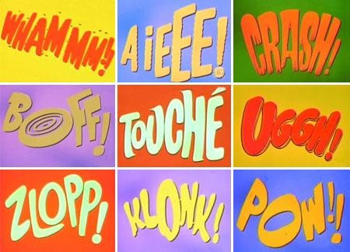
String Index Manipulation
Can manipulate array elements
Be careful!
Here, ‘\0’ (null) was overwritten by a ‘!’
If null overwritten, string no longer ‘acts’ like a string!
Unpredictable results!

Slide 9
String Library
Used for string manipulations
Normally want to do ‘fun’ things with strings
Requires library string.h:
http://en.wikipedia.org/wiki/String.h

Slide 10
String Length: strlen
Often useful to know length of string
strlen(string)
Returns number of characters
Does not include null
Return type is size_t so type cast may be required

Slide 11
= with strings
Strings are not like other variables, they are arrays
Cannot assign:
Must use string library function for assignment:
strcpy(destination, source)
NO checks for size – up to programmer!
‘Assign’ value of msg to “Hello”:
Or strncpy(destination, source, limit)
No ending null character if limit is reached

Slide 12
== with strings
Cannot use operator == to compare
Must use strcmp string library function to compare:
strcmp(string1, string2)
Returns zero int if string1 is equal to string 2
Returns <0 int if string1 is less than string2
Returns >0 int if string1 is greater than string2

Slide 13
String Concatenate: strcat
Appends one string onto end of another
strcat(destination, source)
Be careful when concatenating words
msg1 is missing space after Hello
msg2 is correct

Slide 14
String Parameters to Functions
A string is an array, so
String parameter is an array parameter
Strings passed to a function can be changed by the receiving function!
Like all arrays, typical to send size as well
Function could also use ‘\0’ to find end

Slide 15
String Input and Output
Watch input size of string
Must be large enough to hold entered string!
➢ + ‘\n’ perhaps
➢ + ‘\0’
C gives no warnings of input size issues!
Functions in stdio.h

Slide 16
Character Input: getchar
Reads one character at a time from a text stream
int getchar( )
Reads the next character from the standard input stream and returns its value
Return type is int!
Will convert if assigned to char

Slide 17
Character Output: %s and putchar
Format string placeholder for string: %s
putchar: Writes one character at a time
int putchar (int outChar)
Writes the parameter to standard output
If successful, returns the character written

Slide 18
String Input: gets
String variable
char *gets (char *strPtr)
Inputs a line (terminated by a newline) from standard input
Converts newline to \0
If successful, returns the string
and also places it in argument
Warning: Does not check length of input
gcc may produce warning message

Slide 19
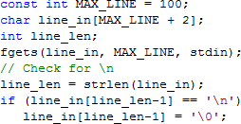
String Input: fgets
String variable
Use stdin for now
char *fgets (char * strPtr, int size, FILE *fp)
Inputs characters from the specified file pointer
through \n or until specifed size is reached
Puts newline (\n) in the string if size not reached!!!
Appends \0 at the end of the string
If successful, returns the string & places in argument

Slide 20
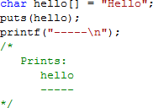
String Output: puts
String variable or constant
int puts (const char *strPtr)
Takes a null-terminated string from memory and writes it to standard output
Writes \n in place of \0

Slide 21
String Output: fputs
String variable
Use stdout for now
int fputs (const char *strPtr, FILE *fp)
Takes a null-terminated string from memory and writes it to the specified file pointer
Drops \0
Programmer's responsibility: Make sure the newline is
present at the appropriate place(s)

Slide 22
Programming in C
T H E E N D

