Slide 1


A distributed streaming platform
By: Fotfi Ghazal and Omar Dhiya Eddine Kherraz

Slide 2
Presentation structure
Introduction
What is Apache Kafka?
Why use Apache Kafka?
How does Apache Kafka work?
Example uses of Apache Kafka
Conclusion
Questions

Slide 3
Introduction

Slide 4
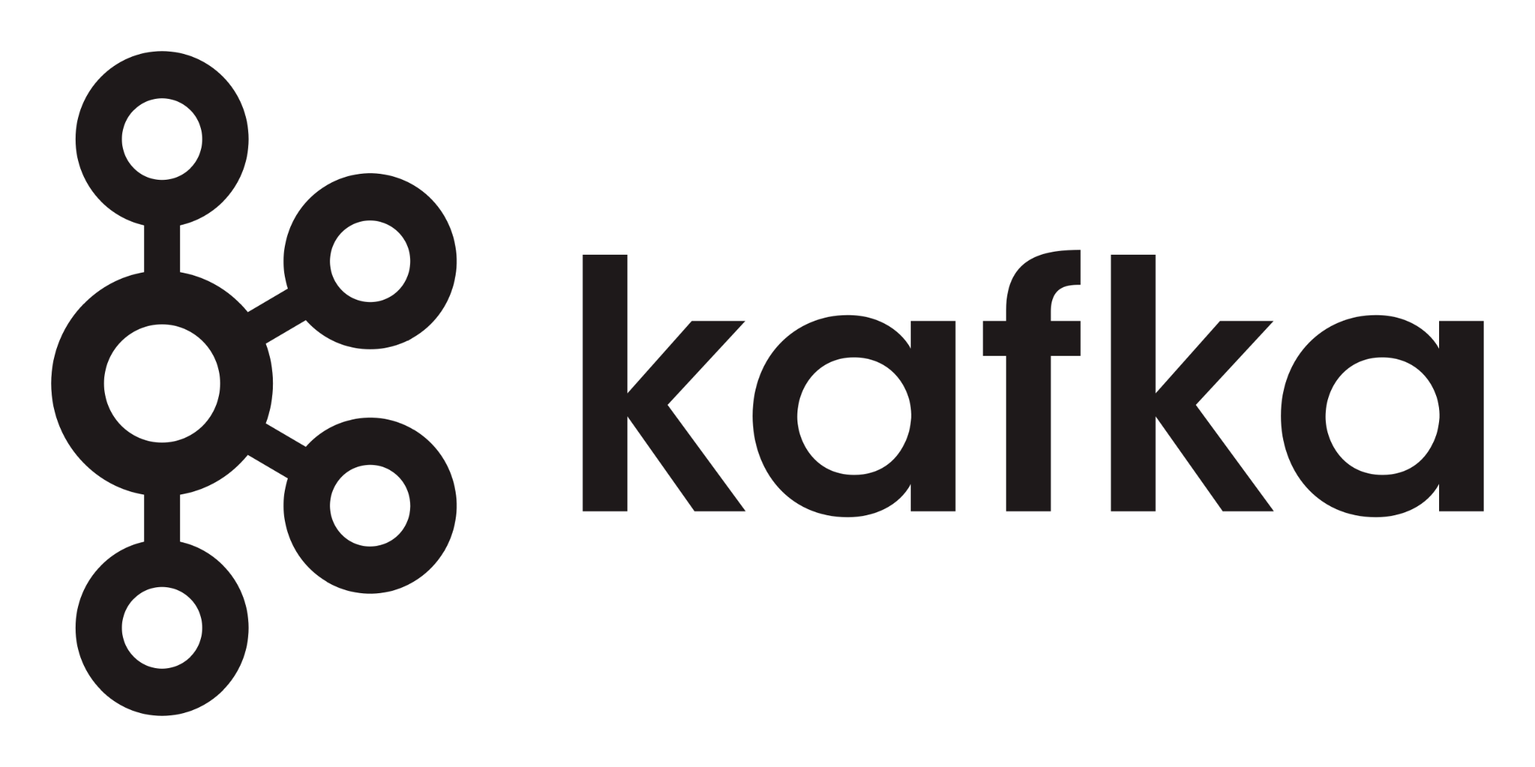
What is Kafka?
Apache Kafka is an open-source distributed event streaming platform used by thousands of companies for high-performance data pipelines, streaming analytics, data integration, and mission-critical applications.
Notes:
da fotfi is da poopyhead

Slide 5

Why use Kafka?
Fixes the "Spaghetti Mess": Instead of a tangled web of direct connections, apps connect only to Kafka.
Acts as a "Central Nervous System": It becomes the single, organized hub for moving data between all different parts of a business.
Handles Massive Speed & Scale: It can process millions of events (like clicks, rides, or payments) instantly without crashing
It Remembers History: Unlike standard messaging, data isn't lost after it's read; it stays in the log and can be replayed later if needed.

Slide 6

How does Kafka work?
Notes:
Lotfi is a poopyhead

Slide 7

The Solution: A Universal Hub
Think of it as a "Smart Pipe"
Apache Kafka acts as a central hub (or nervous system) for all your data.
Instead of 100 different connections, every app just connects to Kafka.
Producer: Sends data into the pipe.
Consumer: Reads data from the pipe.
It decouples your systems, making your architecture clean, fast, and scalable.

Slide 8


Batch Processing vs. Streaming
The Old Way (Batch)
The Kafka Way (Streaming)
Data is collected in a "dump" once a day (e.g., at midnight).
Data arrives event-by-event, millisecond-by-millisecond.
Problem for DS: Your model is always predicting based on yesterday's news. You can't detect fraud *while* it's happening.
Benefit for DS: Your model receives data instantly. You can react, recommend, or alert immediately.

Slide 9

Topic 1
Consumer 1
Event 2
Event 1
Event 2
Consumer 2
Producer
Topic 2
Event 3
Consumer 3
Event 3
Event 2
Event 1
Consumer 4

Slide 10



How It Works: The "Post Office" Analogy
✉
Producers = Senders
Topics = Letters
Consumers = Receivers
Data Science models or other applications "subscribe" to a Topic and instantly receive the relevant updates (the letters) as they happen.
These are applications that generate data (like a person writing a letter) and send it into the Kafka system.
are organized into Topics (like letters for specific addresses). This ensures you only read the data you care about.

Slide 11
Kafka’s relation to Data Science
Notes:
Lotfi is a poopyhead

Slide 12
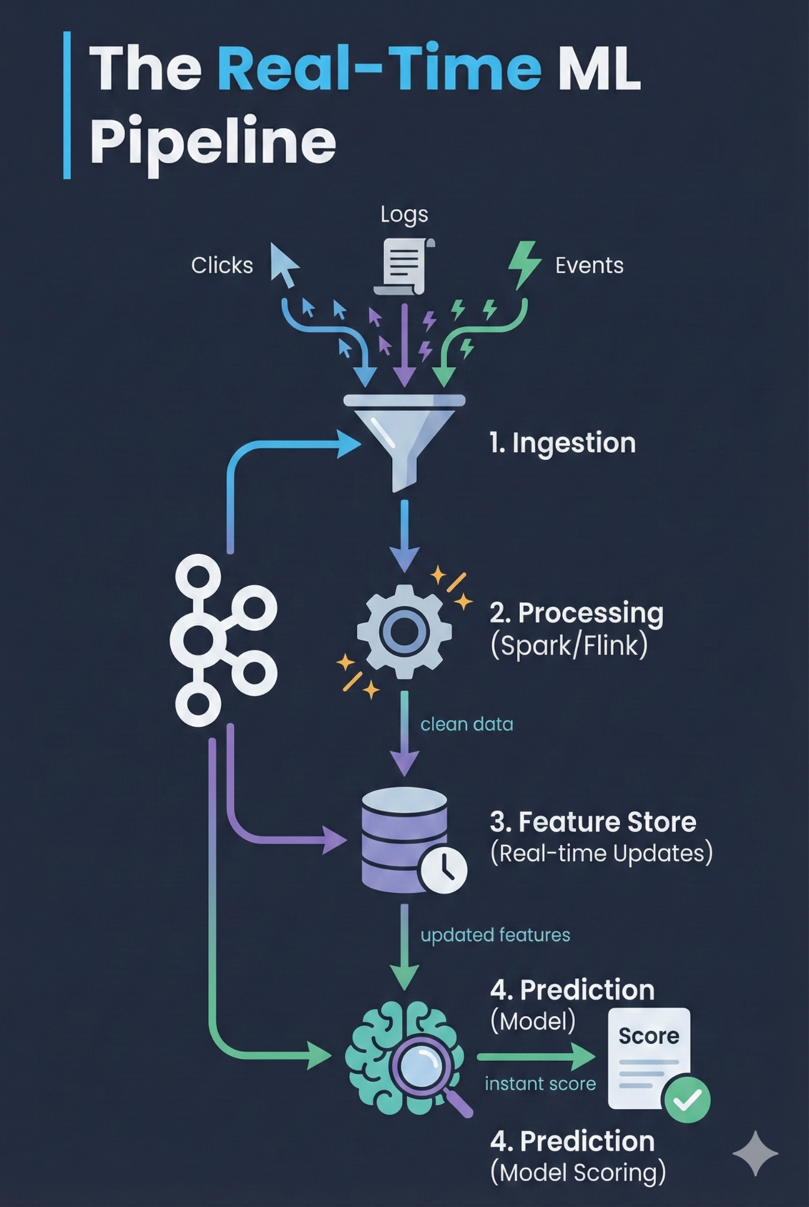
The Real-Time ML Pipeline
Kafka is the backbone of modern Machine Learning architectures.
1. Ingestion: Raw events (clicks, logs) hit Kafka.
2. Processing: Tools like Spark or Flink clean data on-the-fly.
3. Feature Store: Real-time features (e.g., "clicks in last min") are updated.
4. Prediction: The model scores the event instantly.

Slide 13

Spotify's Kafka Use Case
Spotify uses Kafka for real-time recommendations.
It powers personalized music and playlist suggestions
Kafka handles billions of daily streaming events instantly
The platform uses events to update user preferences immediately.

Slide 14
Conclusion
From Mess to Order: We replaced the fragile "Spaghetti Architecture" with a central "Nervous System" for data.
From Past to Present: We moved from asking "What happened yesterday?" to "What is happening right now?".
The Bottom Line: Whether it's blocking a fraudulent credit card or recommending a movie, Kafka allows applications to react instantly to the world as it changes.

Slide 15
Questions?
Go ahead and ask Lotfi not me

