Slide 1


Meet PyTorch: The AI Gym for Machines
A deep learning framework created by Meta, written in Python,
used to train AI models.
present par:
MESBAH AMINA
BOUZID MERIEM
MEKALI SABRINA
Notes:
1.7.2013
1.7.2013
1
‹#›
‹#›

Slide 2


What is PyTorch?
PyTorch is an open-source deep learning library developed by Meta’s AI research team. It enables machines to learn complex patterns and make intelligent decisions, and is widely used around the world.
Notes:
1.7.2013
1.7.2013
2
‹#›
‹#›

Slide 3





Core Capabilities: What PyTorch Can Do
Voice & Speech Analysis
Text Generation
Image Recognition
Advanced visual processing and object detection.
Understanding and generating human language.
Advanced visual processing and object detection.
Self-Driving Systems
Medical AI
Advanced visual processing and object detection.
Advanced visual processing and object detection.
Notes:
1.7.2013
1.7.2013
3
‹#›
‹#›

Slide 4

Core consepts

Slide 5






1. TENSORS – THE BUILDING BLOCKS:
Everything in PyTorch starts with a tensor. Think of a tensor as a supercharged NumPy array . It can store data, run on your CPU or GPU, and move huge amounts of numbers really fast. In simple terms: tensors are how PyTorch sees the world .
images, text, sound… all turn into tensors.”

Slide 6
A Simple Program Example :
from PIL import Image
from torchvision import transforms
image file in the same folder)
image = Image.open("pp.jpg")
transform = transforms.ToTensor()
tensor_image = transform(image)
print("Tensor shape:", tensor_image.shape)
print("Tensor values (first pixel):", tensor_image[:, 0, 0])
Tensor shape: torch.Size([3, 538, 603])
Tensor values (first pixel): tensor([0.2745, 0.2314, 0.1529])
output:
Notes:
1.7.2013
1.7.2013
8
‹#›
‹#›

Slide 7
import torch
x = torch.tensor([2.0, 3.0], requires_grad=True)
y = x**2 + 3*x + 2 # y = x^2 + 3x + 2
z = y.sum()
z.backward()
print("x.grad:", x.grad)
2. AUTOGRAD – THE BRAIN’S LEARNING MECHANISM
Autograd is PyTorch’s automatic differentiation system — it tracks operations and automatically computes gradients, allowing the model to learn by adjusting weights without manual math.
x.grad: tensor([7., 9.])

Slide 8
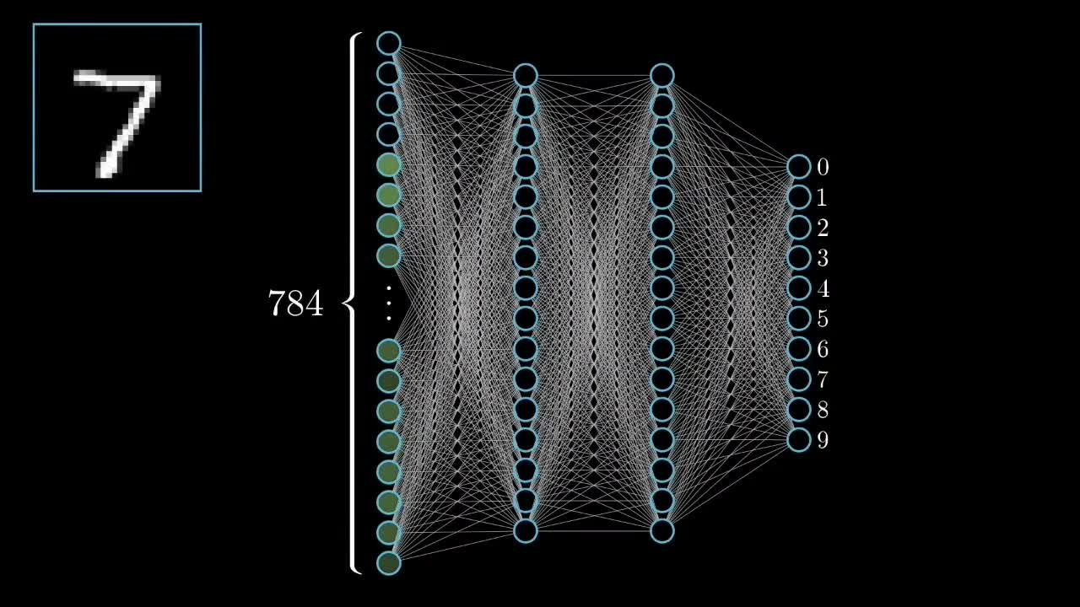
3. NEURAL NETWORKS – THE MODEL BUILDER
Then comes the fun part: building neural networks. PyTorch gives you a module called torch.nn that lets you stack layers together like LEGO blocks — input, hidden, output — and create models that recognize patterns, predict results, or even generate images.

Slide 9





4. OPTIMIZATION – HOW THE MODEL IMPROVES
During optimization, the model compares its predictions to real answers, measures the error, and improves with each round , almost human-like process where the computer learns from its mistakes, gets smarter, and starts thinking a bit more like us.

Slide 10


Why Developers Choose PyTorch
Developers appreciate PyTorch for its intuitive design and powerful features, making the AI development process faster and more flexible.
Easy and Pythonic
Dynamic and Flexible
Integrates seamlessly with the Python ecosystem, making it easy to learn and use.
Uses dynamic computation graphs, allowing for rapid prototyping and experimentation.
Great GPU Support
Huge Open-Source Community
Optimized for high-performance computing using GPUs for faster training.
Supported by a massive, active community contributing to its growth and stability.
Notes:
1.7.2013
1.7.2013
1.7.2013
4
‹#›
‹#›
‹#›

Slide 11





PyTorch Powers the World's Leading AI Labs
PyTorch is the framework of choice for almost every big AI lab in the world, driving innovation across industries.
Notes:
1.7.2013
1.7.2013
1.7.2013
5
‹#›
‹#›
‹#›

Slide 12


PyTorch in 2025: Future Relevance
Top Tier Framework
It will remain one of the top two AI frameworks globally, essential for large-scale projects.
Essential Career Skill
Proficiency in PyTorch is a mandatory skill for most high-demand AI and Machine Learning jobs.
Research Standard
PyTorch is the standard tool used in academic research and university AI programs.
Notes:
1.7.2013
1.7.2013
1.7.2013
6
‹#›
‹#›
‹#›

Slide 13


Key Takeaways: Your AI Journey Starts Now
PyTorch Teaches Machines
Flexible and Powerful
1
2
It provides the environment for training sophisticated AI models.
Its dynamic nature supports complex research and development.
Used Everywhere
Be the Next AI Hero
3
4
Adopted by industry leaders and academic institutions globally.
Mastering PyTorch is your gateway to a career in cutting-edge AI.
Notes:
1.7.2013
1.7.2013
9
‹#›
‹#›

Slide 14


Questions?
Be like the PyTorch superhero — keep learning!
Notes:
1.7.2013
1.7.2013
10
‹#›
‹#›

